Slide 1
Microsoft Teams support for pupils and parents

Slide 2
Included in the guide
How to complete daily registration
Locating & submitting work in Assignments using a Laptop or Tablet
Joining meetings with Class teachers or Assemblies
Using immersive reader
FAQ &
Troubleshooting

Slide 3
How to complete Daily registration

Slide 4
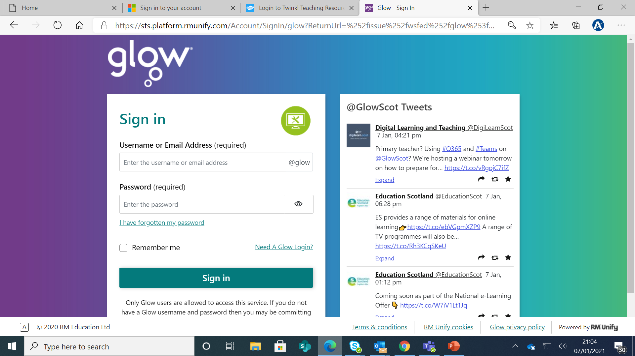
You can login using the Teams App or on the web using Glow sign.
The page looks like this.

Slide 5
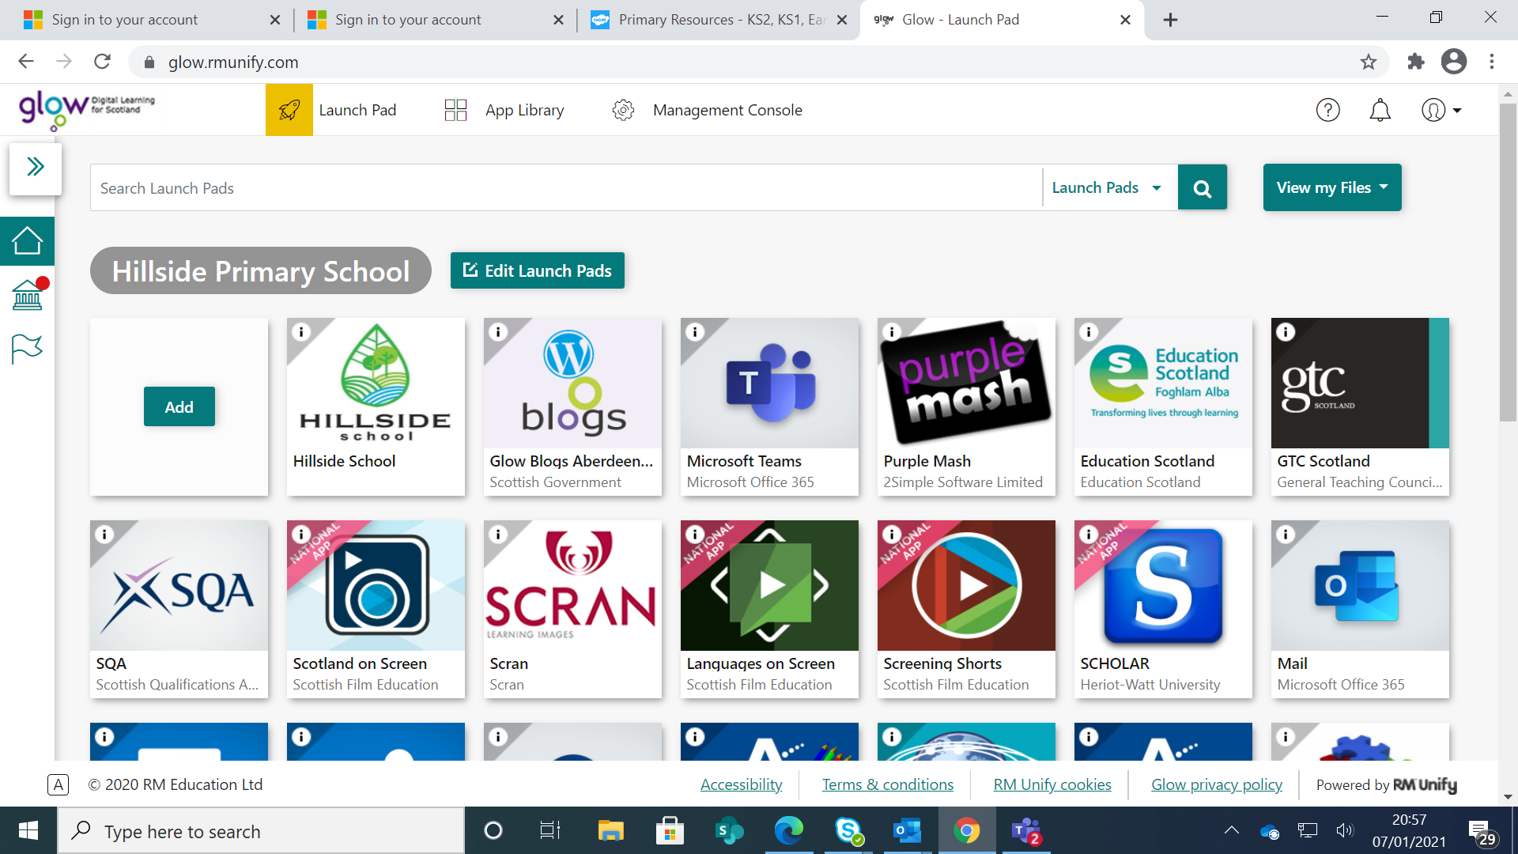
Select the Teams tile from the Home Page.

Slide 6
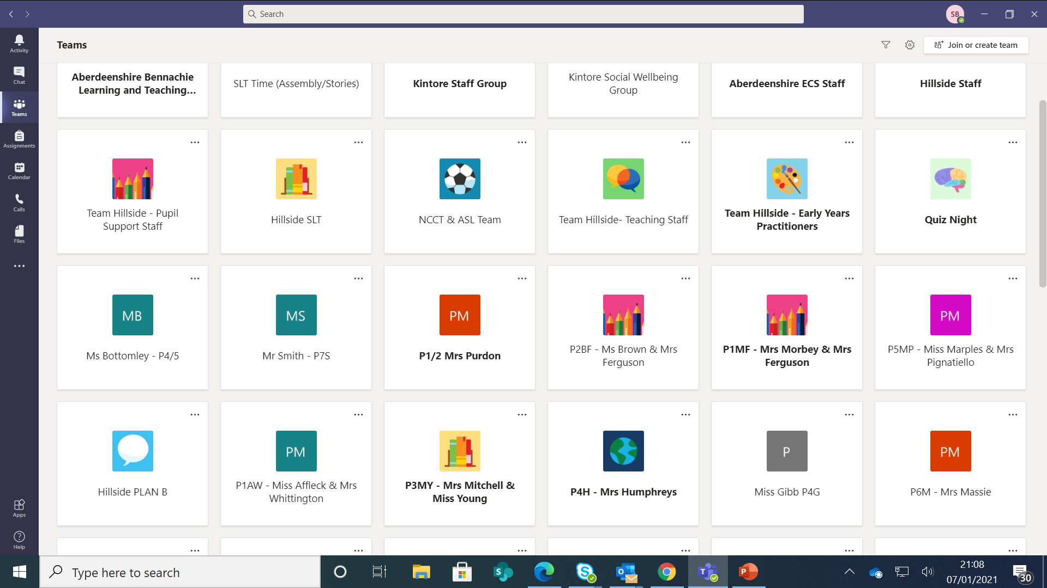
Select your child’s class team tile.

Slide 7
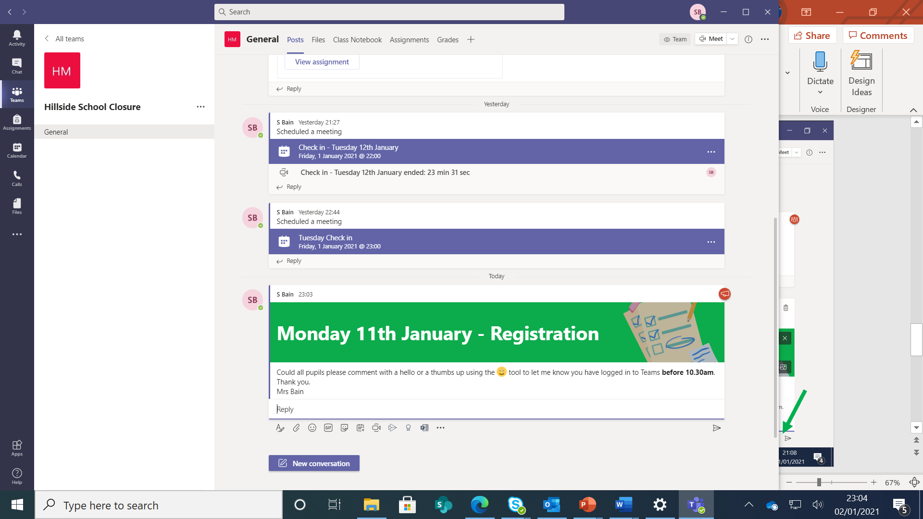
Daily announcements will be posted on the General Teams channel.

Slide 8
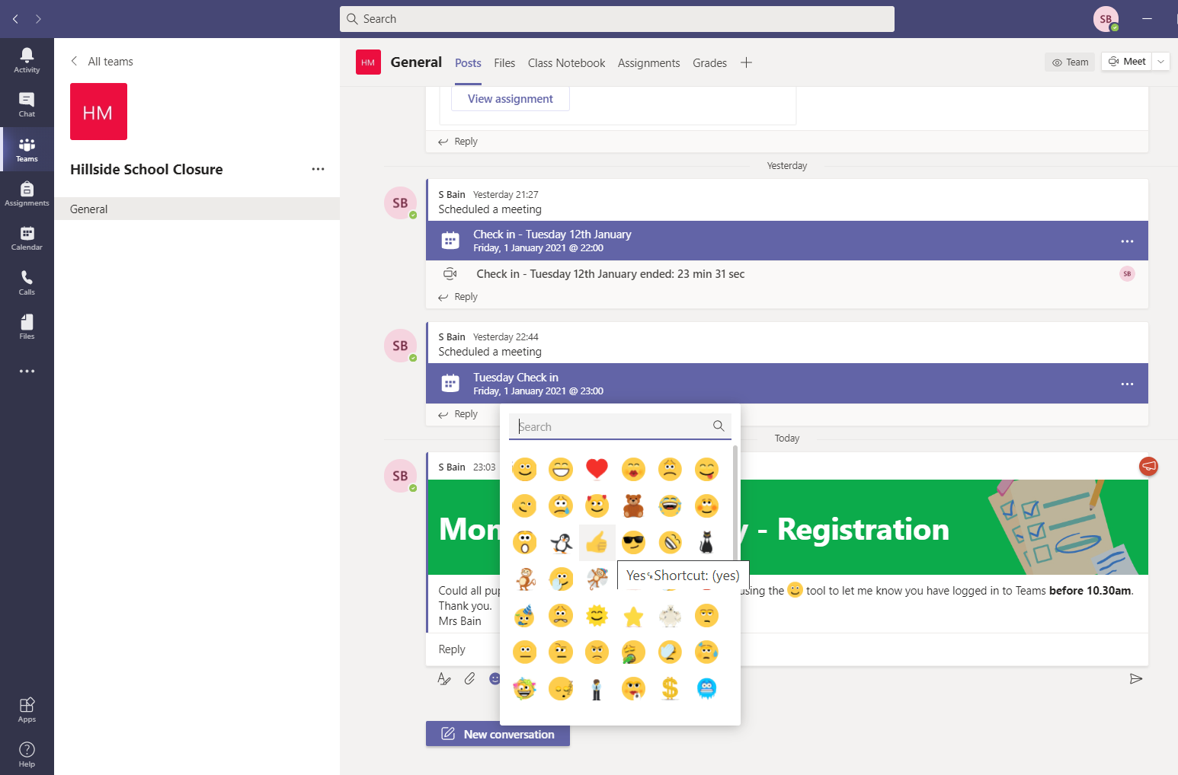
Click the reply icon and type hello OR click on the emoji icon and select the thumb image.
We would ask registration is completed by 11.30am. Assignment Tasks may be completed at any time of the day.

Slide 9
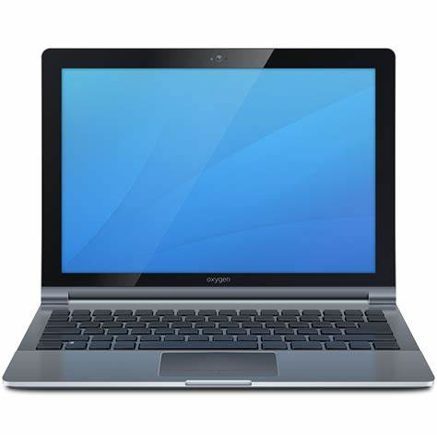
Locating & submitting work in Assignments using a laptop

Slide 10
Select your child’s class team tile.

Slide 11
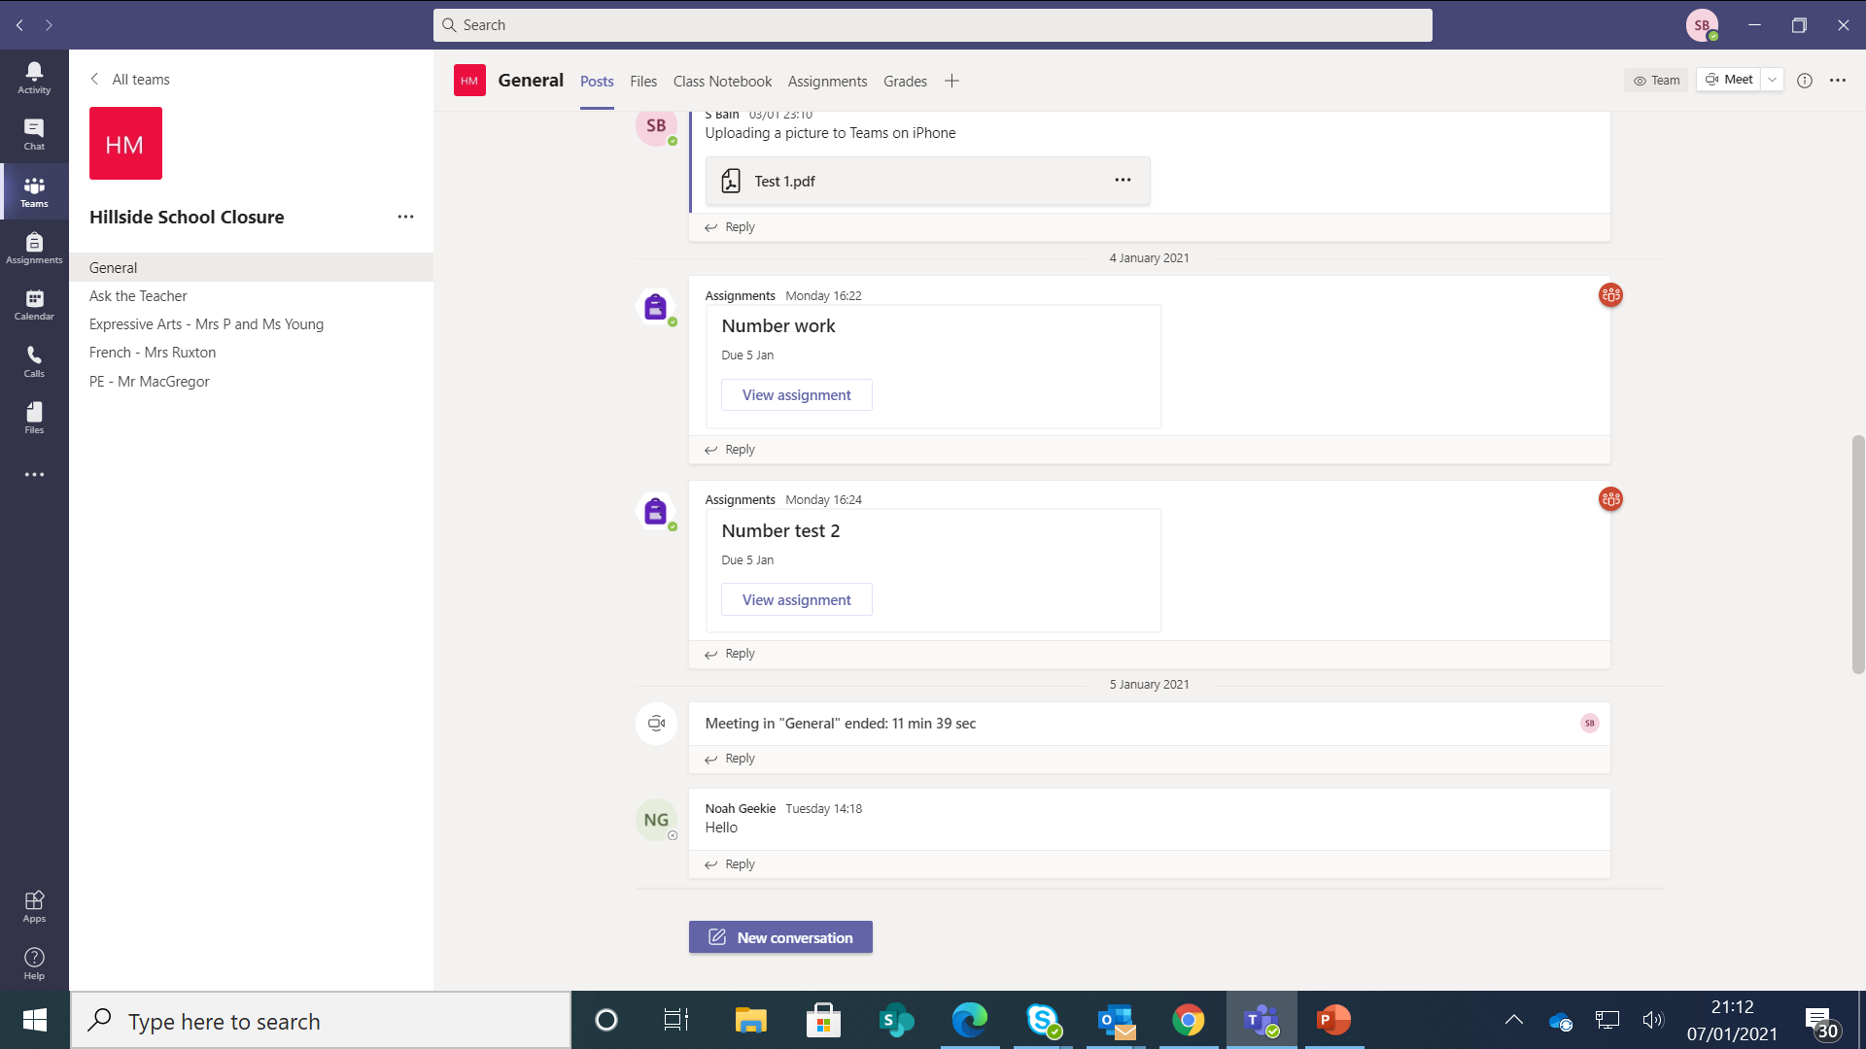
Assignments may be posted on the general channel or in labelled channels on the left-hand side.

Slide 12
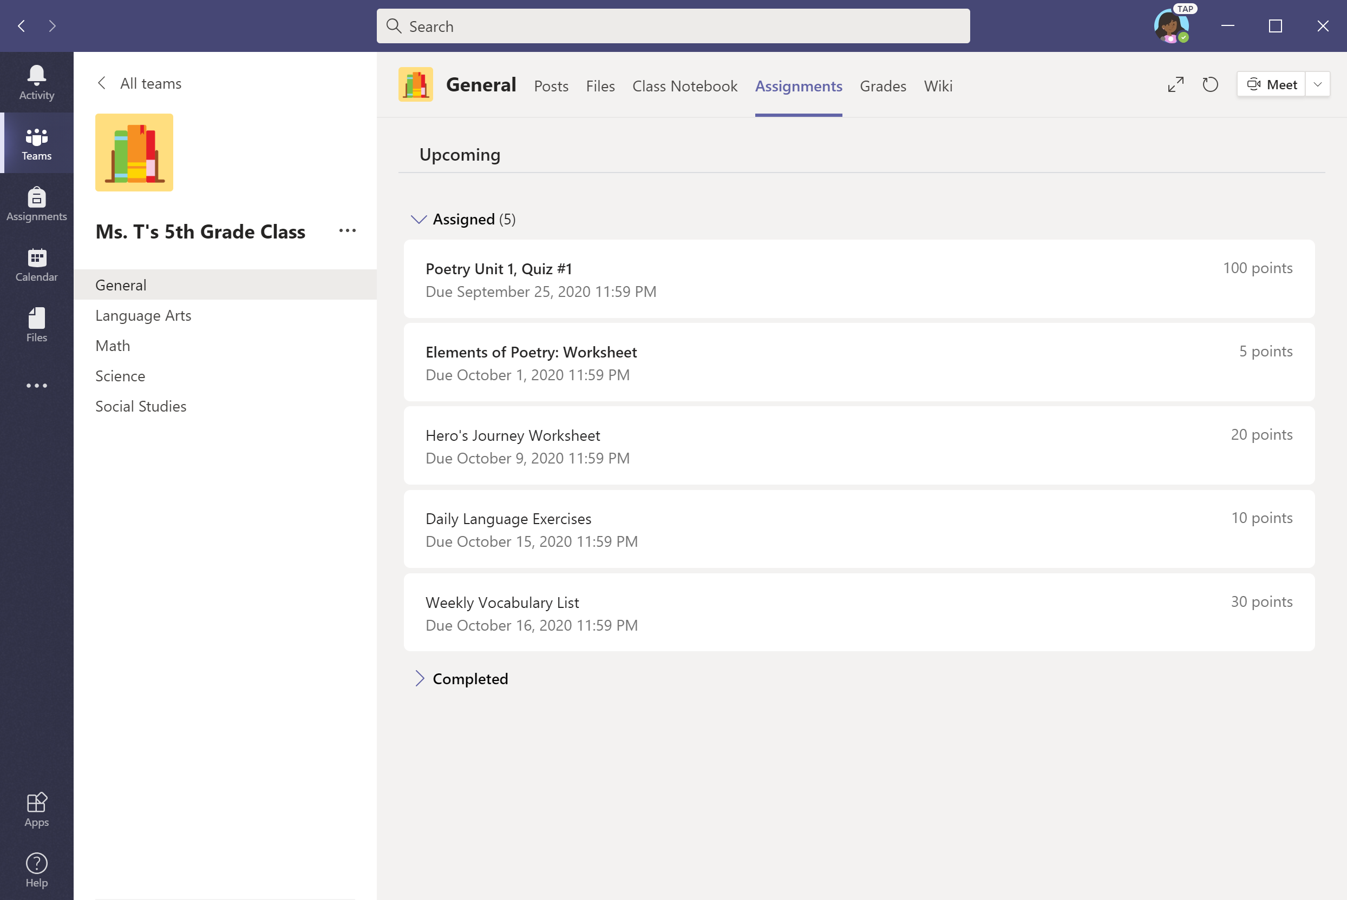
Option #1: To view all assignments, go to the General channel & select the Assignments tab.

Slide 13
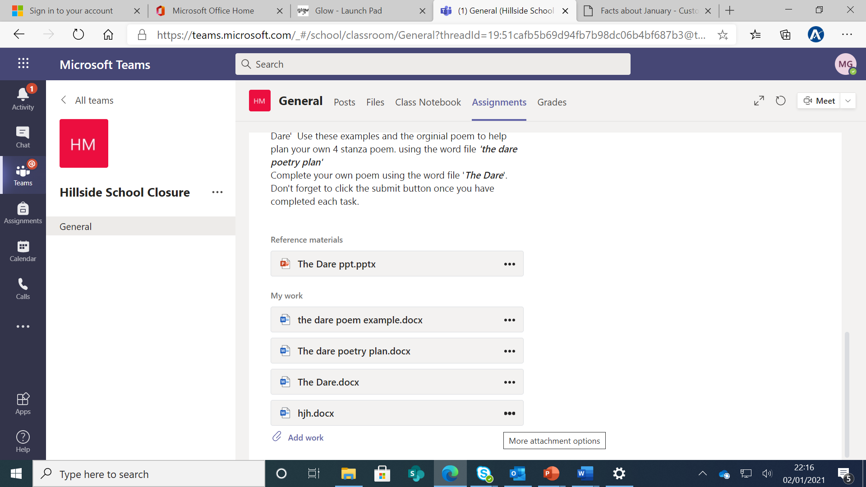
The task instructions will be here and documents for your child to edit or add their own file.

Slide 14
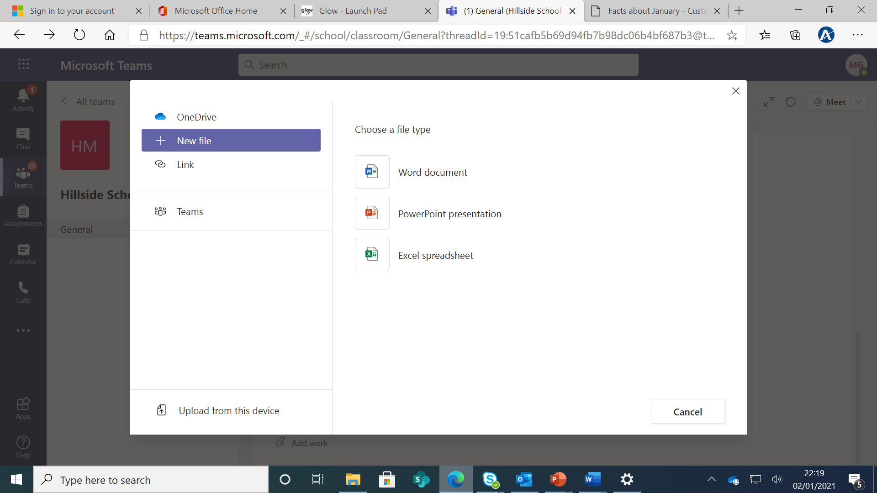
You have 3 options if adding a new file (Word Document, PowerPoint or Excel)
You must click on the file type and give it a name.
It will appear on the assignment page.

Slide 15
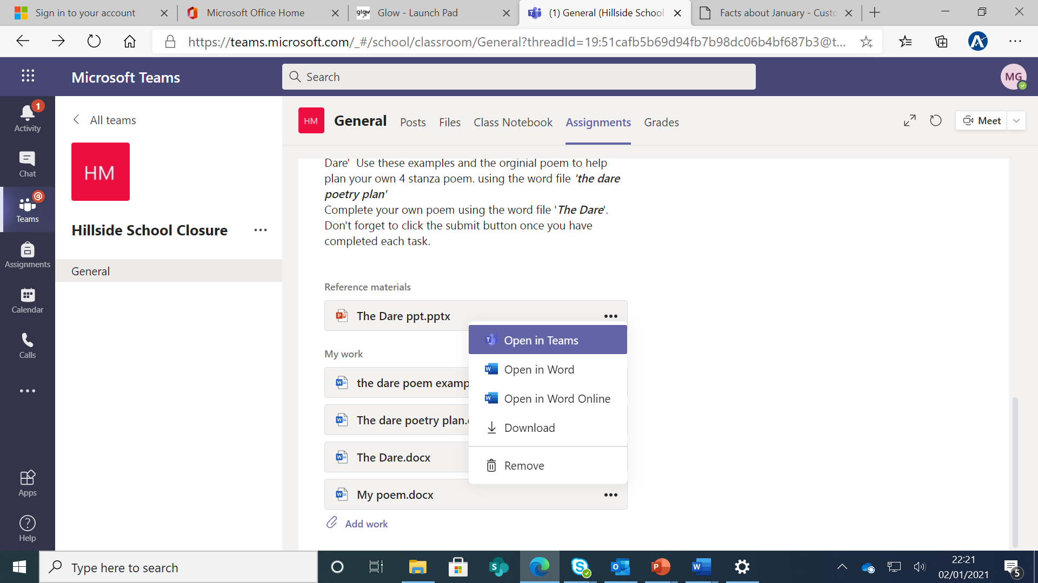
Click on the 3 dots (…) for the file you created and select one of the following options. Open in Teams is the easiest option. Complete the task within that document.
If you have added a document in error, select Remove.

Slide 16
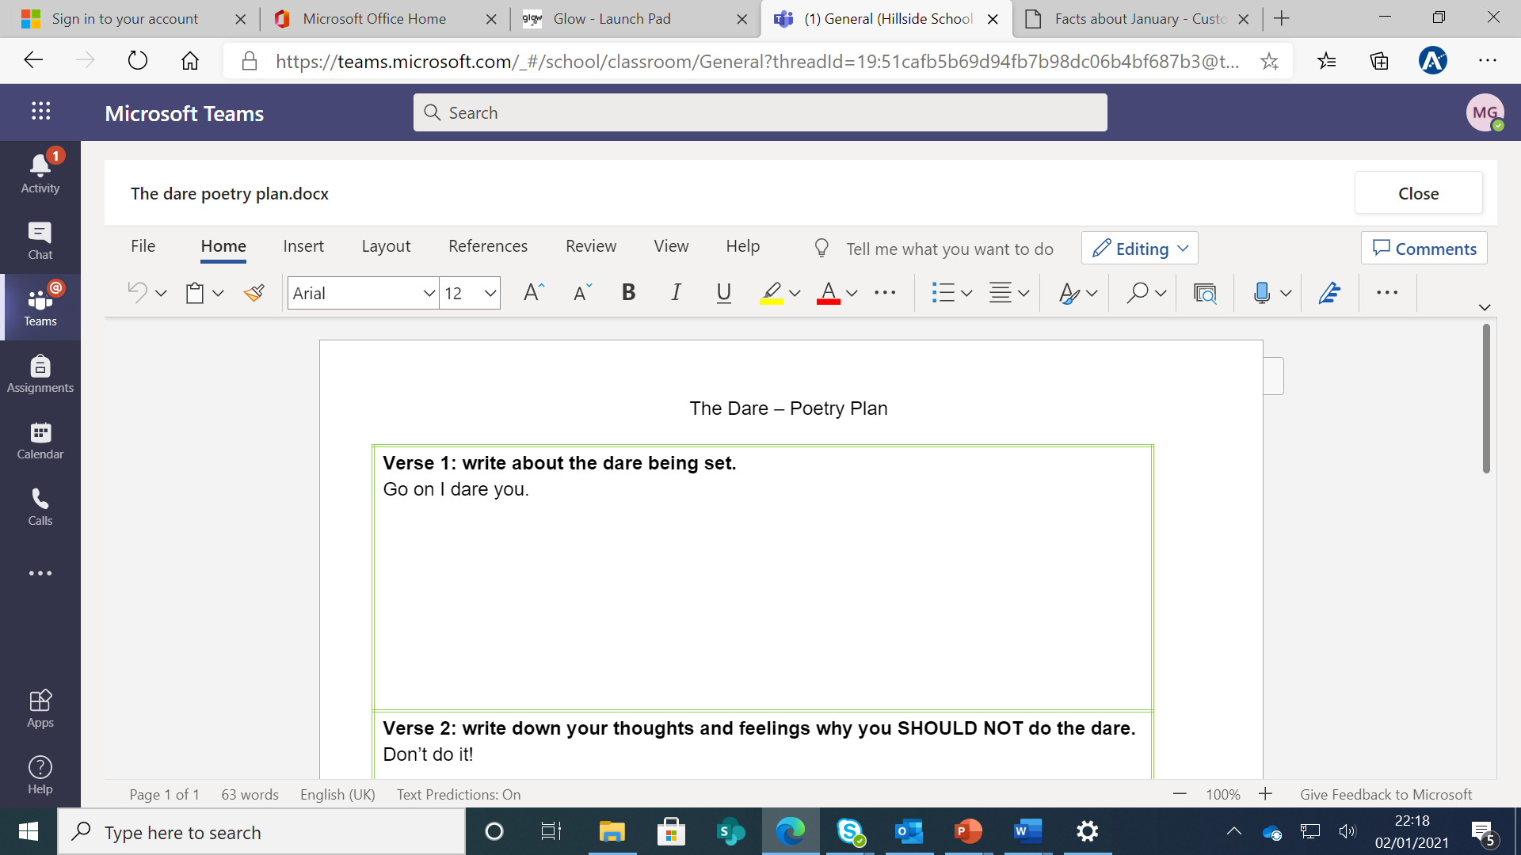
If you select open in Teams. This is how the document appears. Once you have completed the task.
Click Close and it will save your child’s work, but it will not be submitted to the class teacher until you click Turn In/Hand in.

Slide 17
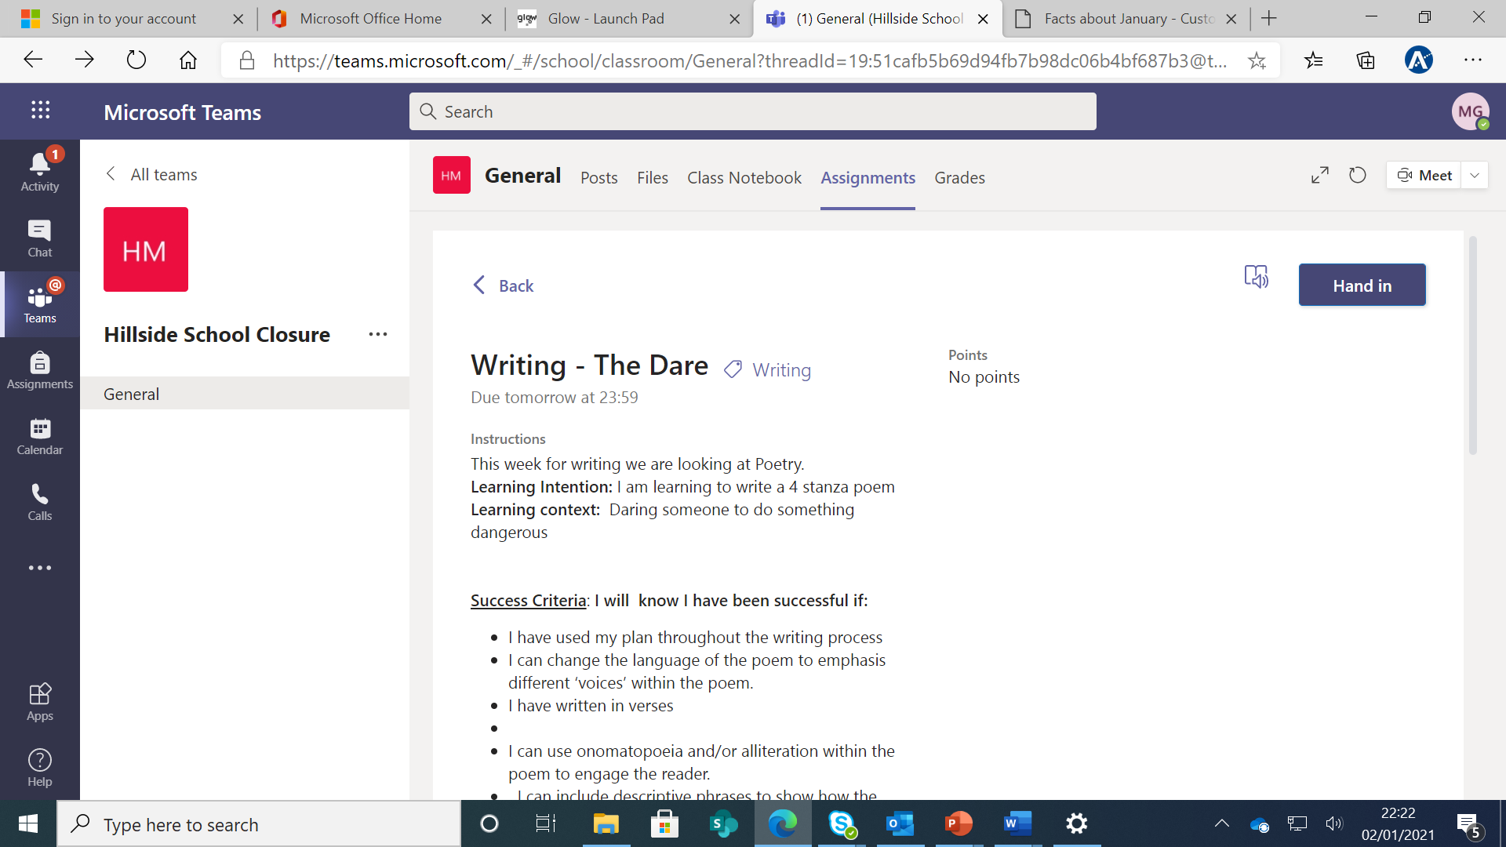
Click Turn In/Hand in to submit assignment.

Slide 18
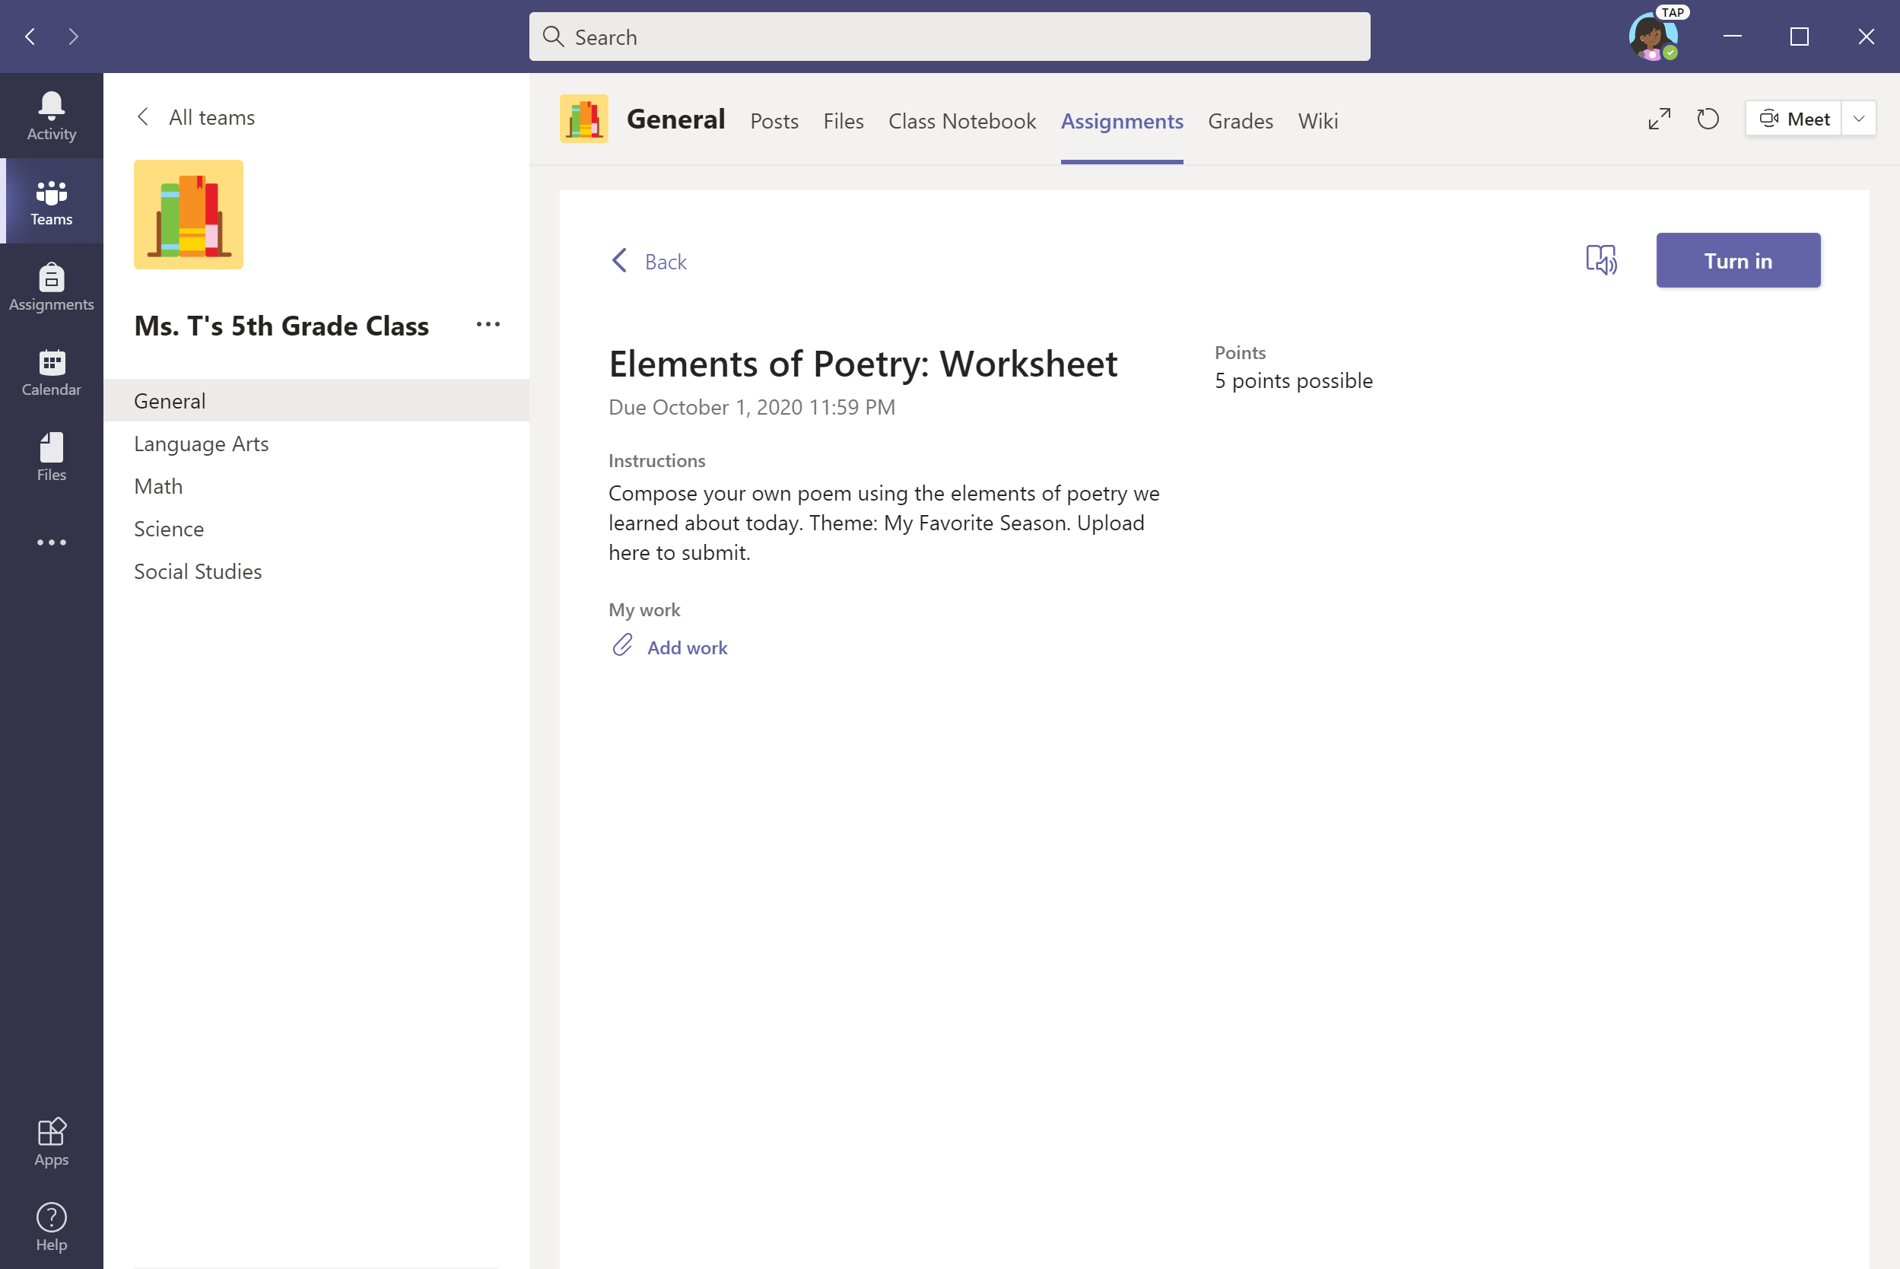
To upload work, select + Add work.

Slide 19
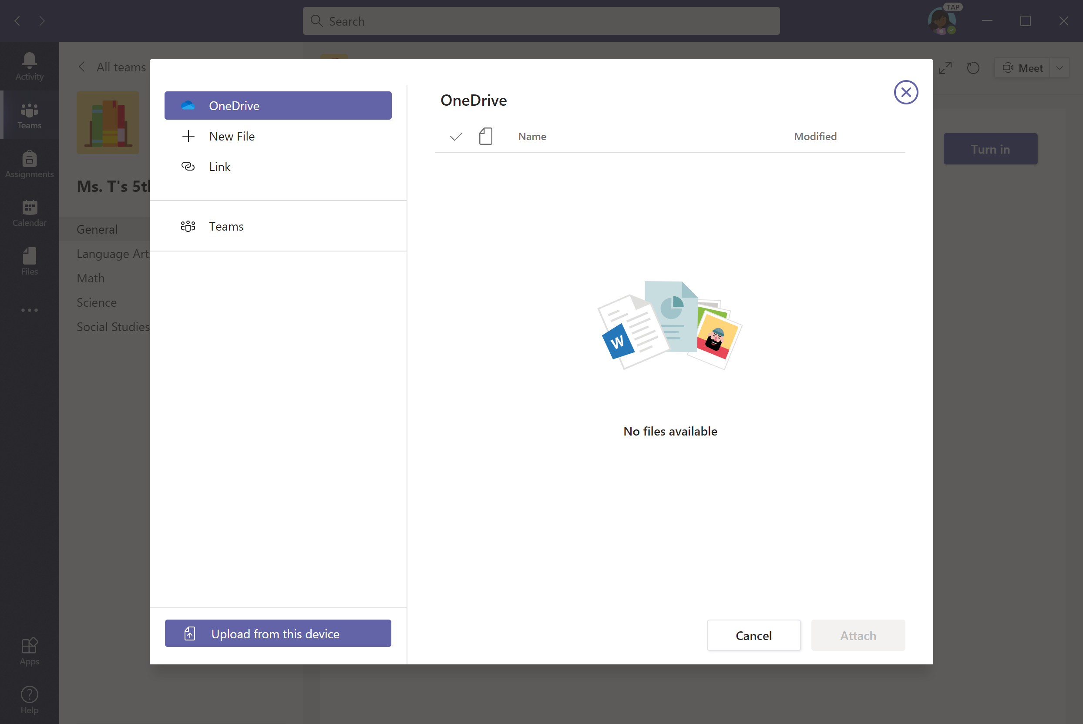
Upload file from your device, OneDrive, Teams, or a link. Let’s upload from device for this example.

Slide 20
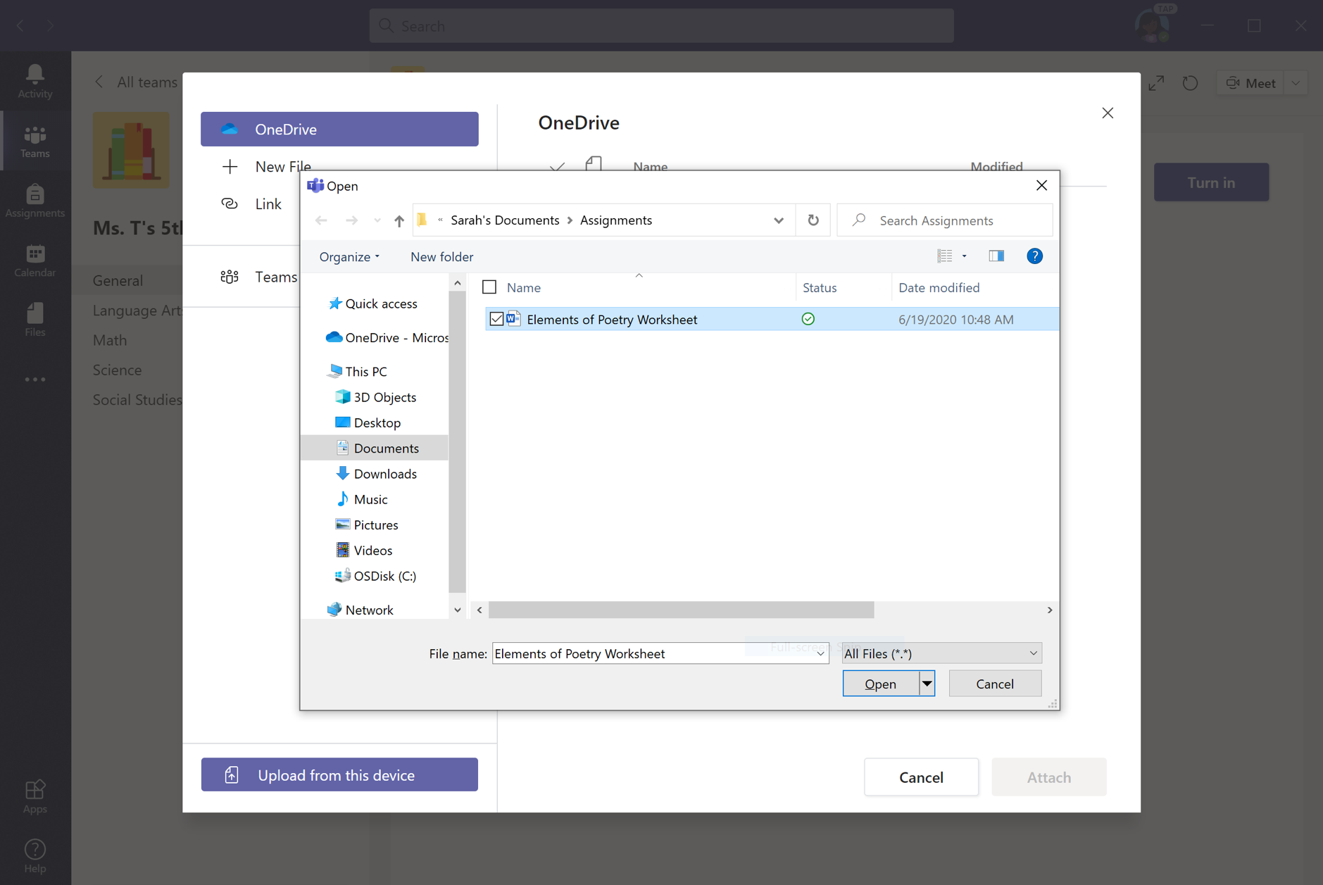
Select file and click Open.

Slide 21
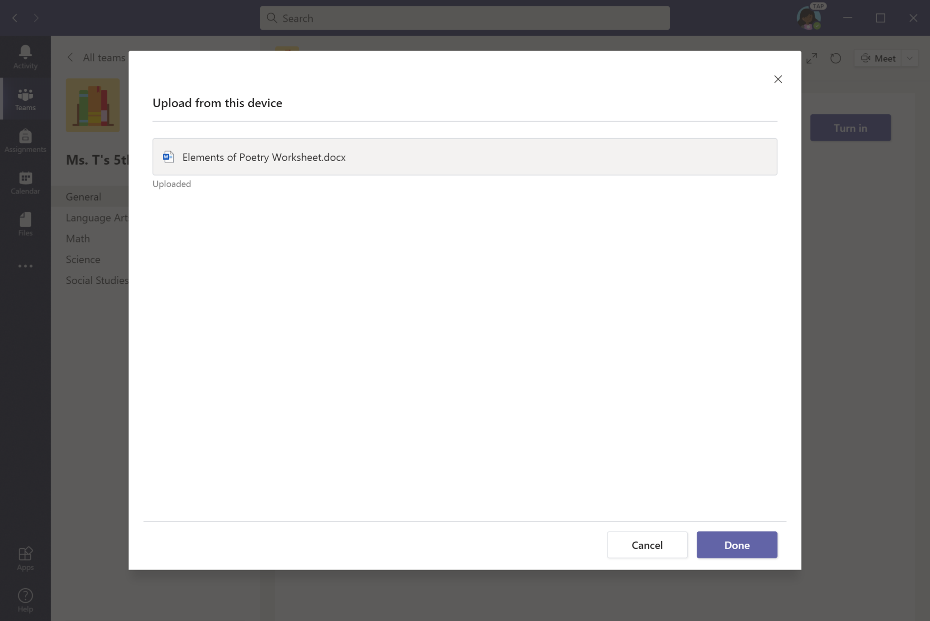
Click Done—but you’re not done yet.

Slide 22
Click Turn In/Hand in to submit assignment.

Slide 23
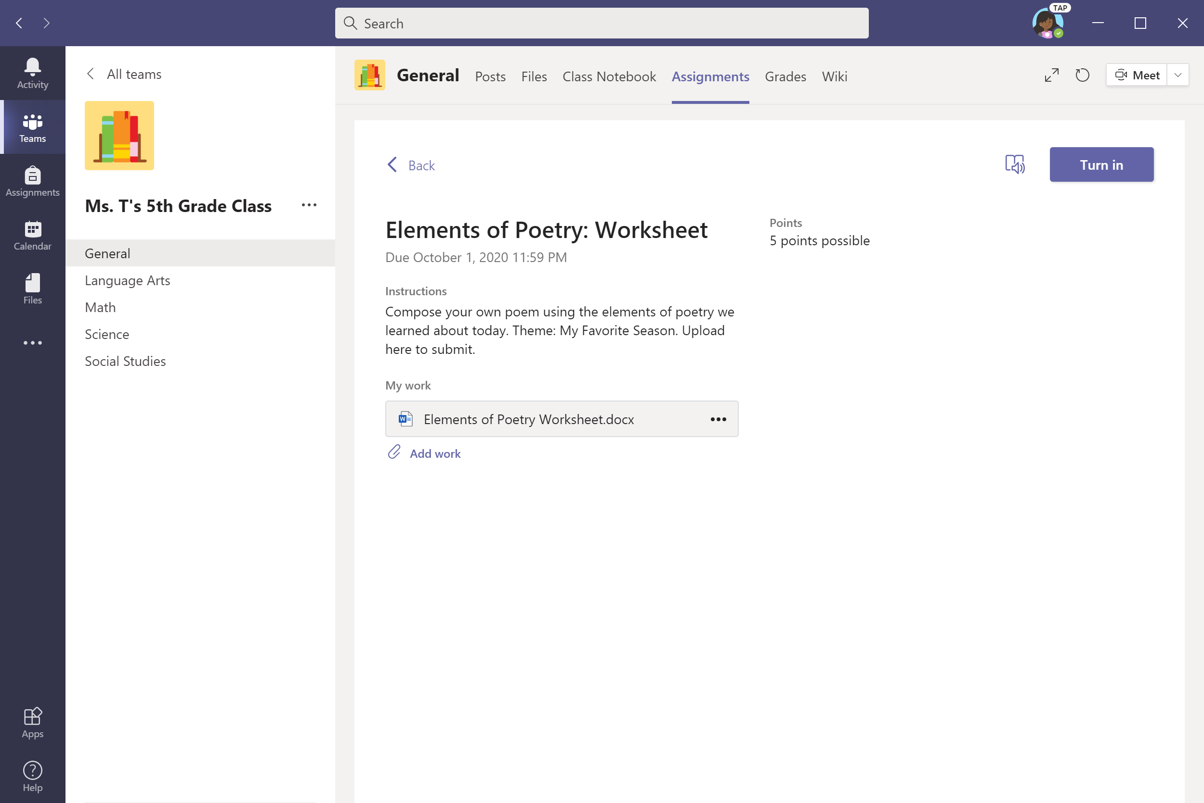
An animation will signal that the assignment has been submitted.

Slide 24
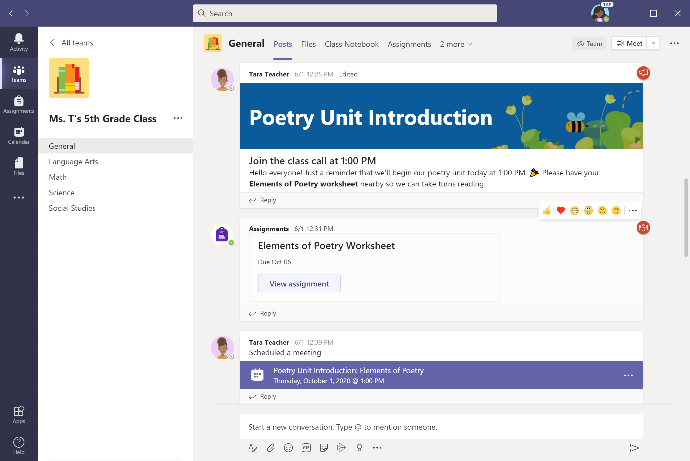
Another option for turning in assignments: View assignments from the Posts tab in the General channel or labelled channels at the side.
Notes:
Box focus in on ‘view assignment’

Slide 25
To upload work, select + Add work. Proceed as shown in previous slides.

Slide 26
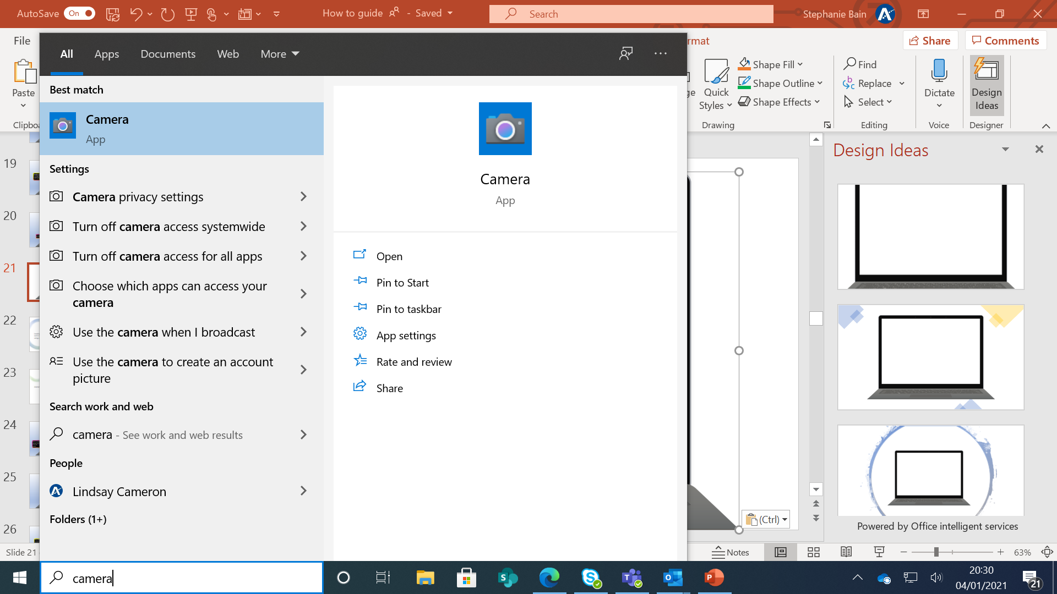
To upload a picture. Search camera in the windows brower.

Slide 27
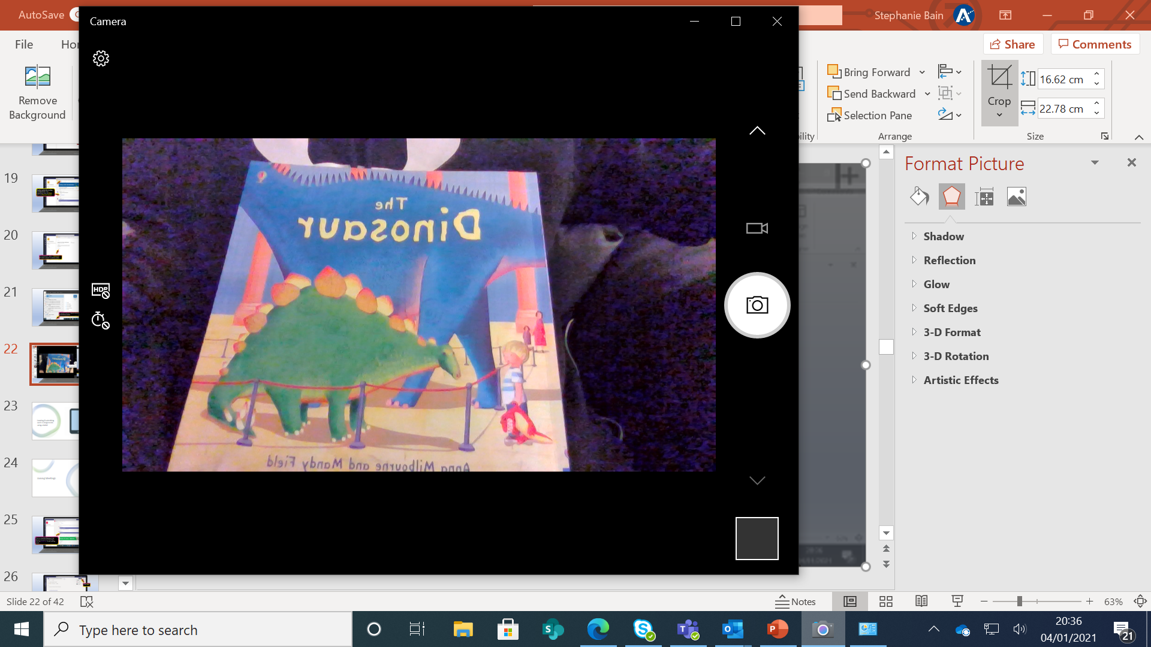
Hold the picture up to the camera and press the camera icon. It should automatically save the file to your picture folder on your device.

Slide 28
To upload the photo, select + Add work.

Slide 29
Select upload from device to add the photo.

Slide 30
Select picture file and click Open.

Slide 31
Click Done—but you’re not done yet.

Slide 32
Click Hand in/Turn in to submit assignment with your photo.

Slide 33
Locating & submitting work in Assignments using a tablet

Slide 34
Download The Microsoft Teams and Microsoft Office Apps to your tablet or phone.
These are free apps and work on Android or Apple devices.

Slide 35
For both apps, you will be asked to login in with an email.
Use your glow email address for this.
Eg gw18bainstephanie@glow.sch.uk
This will take you to the Glow page where you will need to sign in again using your Glow email and password.
This will allow you to access assignments and any documents assigned by class teachers to complete.

Slide 36
This will allow you to see all of the Teams your child is part of and view assignments.
These will be in the assignments tab at the bottom of the screen.
Click view assignment to see the specific task.

Slide 37
Click on the document(s) listed below the heading My work.
Click on the file. This will open the document in the Microsoft office app.
(It might take a while for documents to load initially. (Don’t worry, it will open)
To edit this document you need to click the pencil icon.

Slide 38
Work automatically saves in this app as you type.
Once you have completed the task. You should exit the app and return to Microsoft Teams.

Slide 39
The document you worked on will now be attached to the assignment.
You must click Hand in to submit the work to your class teacher.
If you wish to add a photo or other documents.
Click Add work

Slide 40
Once you have clicked Add work, you will see this option.
You can add documents or upload a photo of your work.
Once you have attached any extra documents.
Click Turn In/Hand in button to submit the work.

Slide 41
Joining Meetings on any device

Slide 42
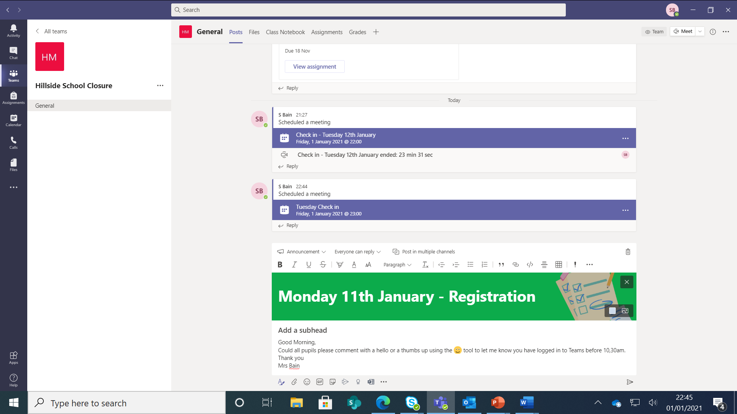
Click on scheduled Meeting in the General channel of the Class Team. Click the purple bar to see meeting details.

Slide 43
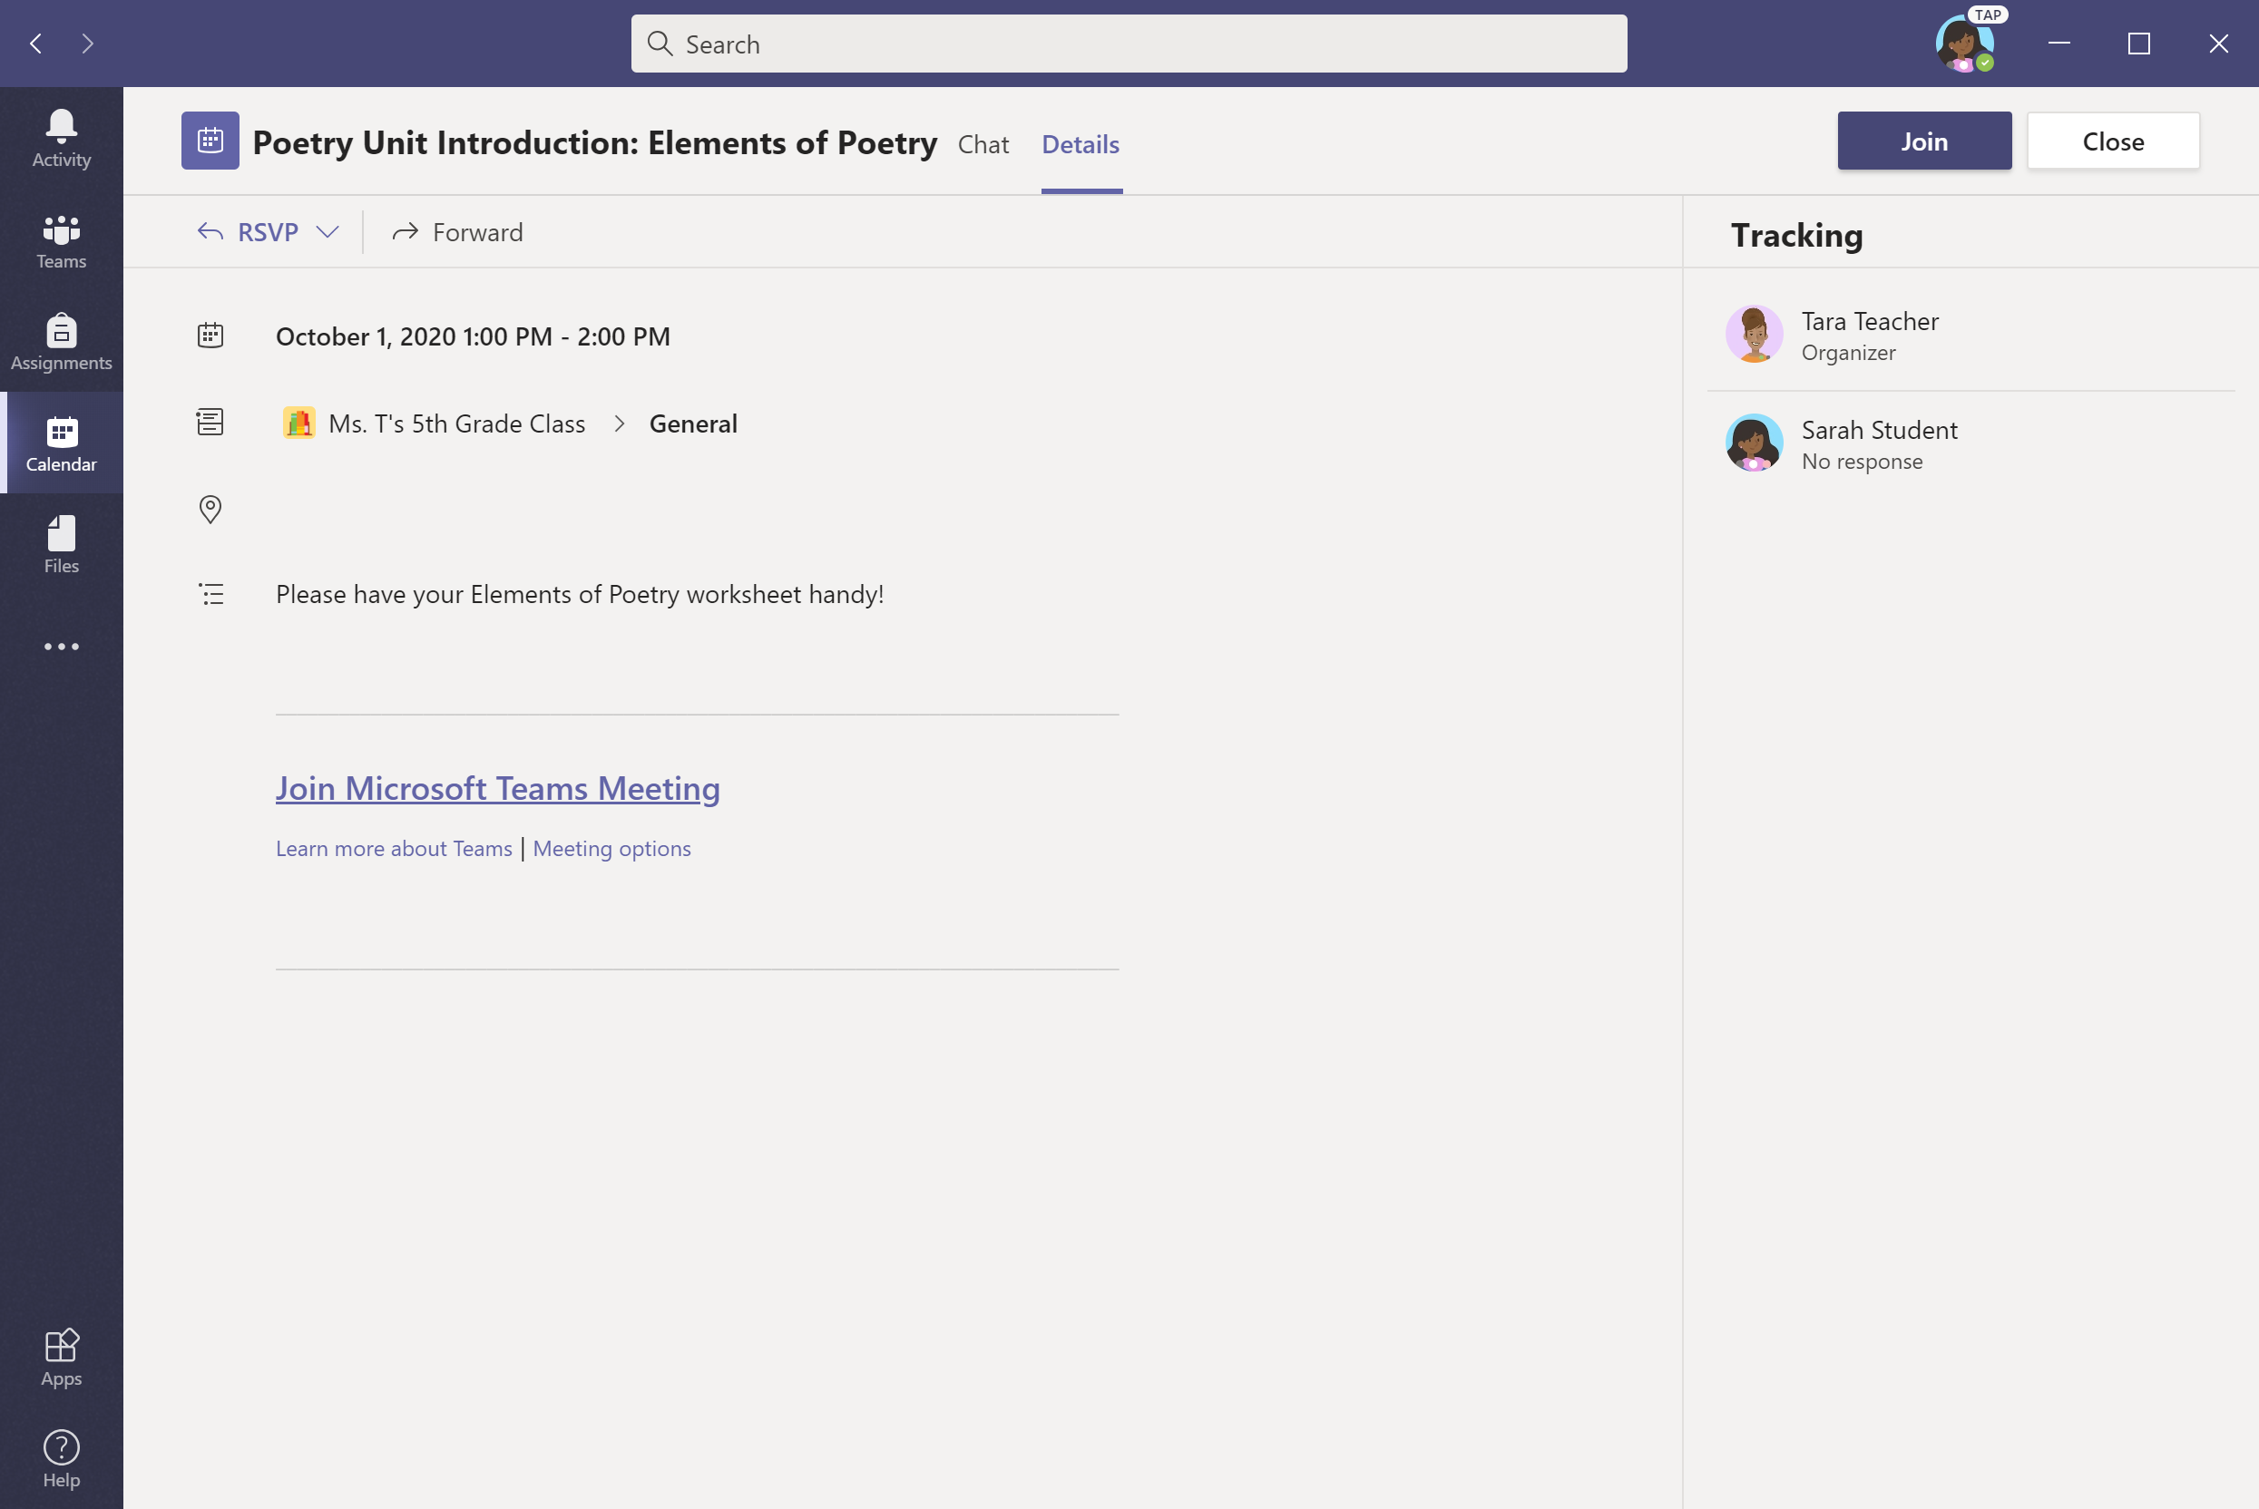
Click Join.

Slide 44
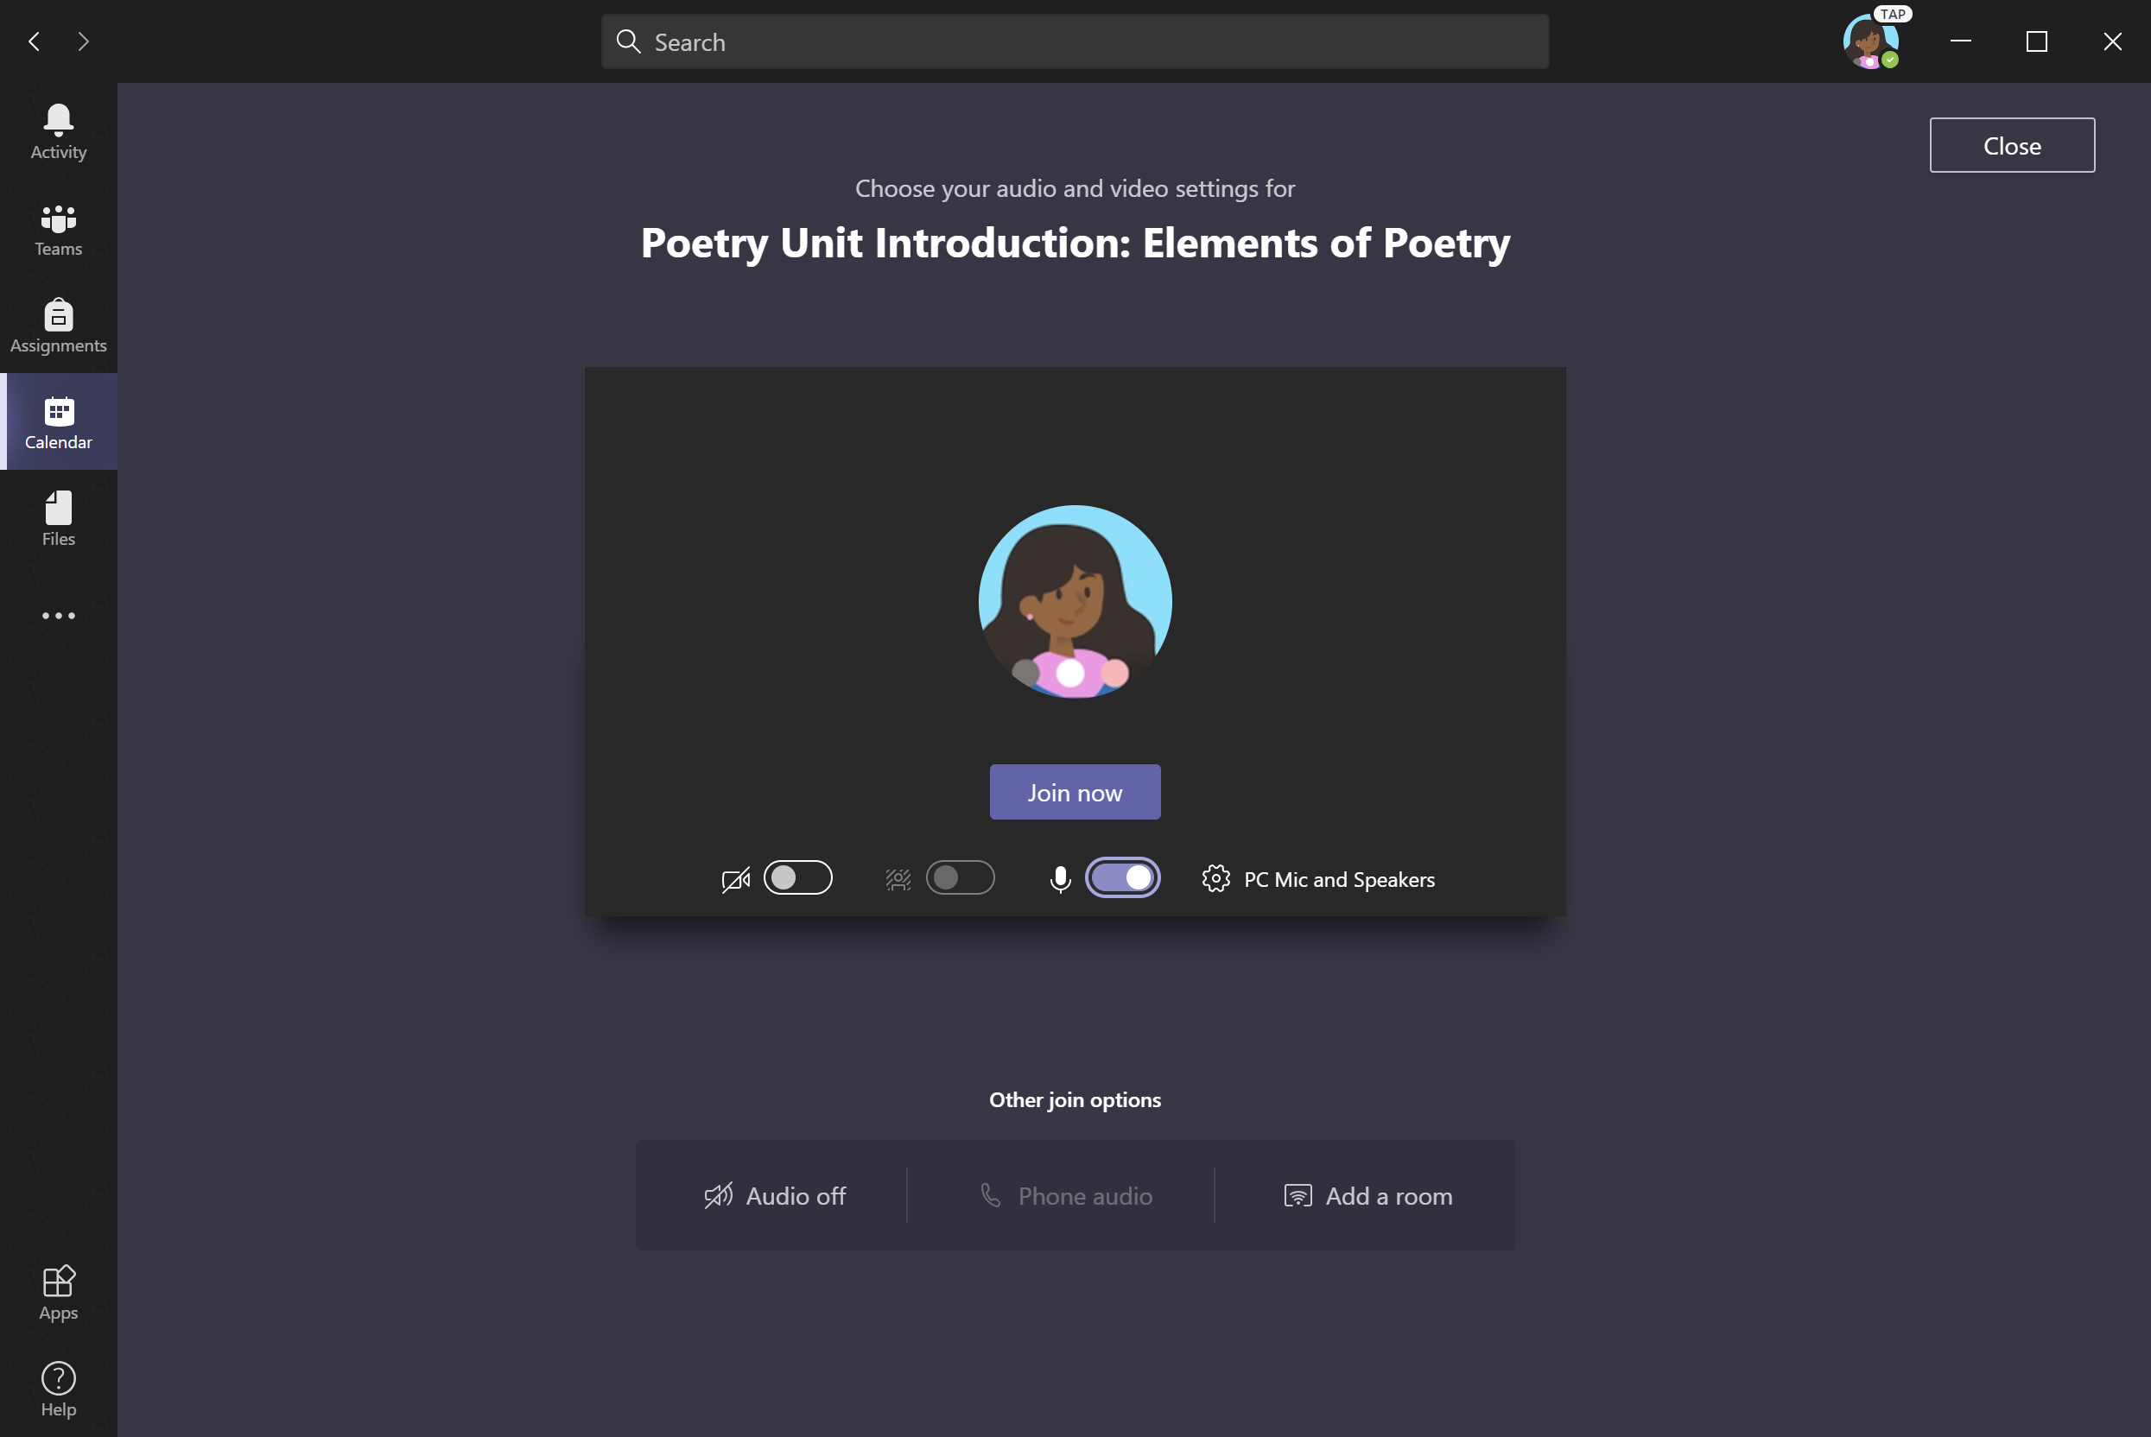
Turn video camera and microphone on/off as appropriate. Click Join now.
Note: Before joining the meeting, your child might enter a virtual lobby where they will wait until the teacher starts the meeting.
This helps teachers control when the meeting starts. Not all teachers will use this feature so some pupils may not see this screen.

Slide 45
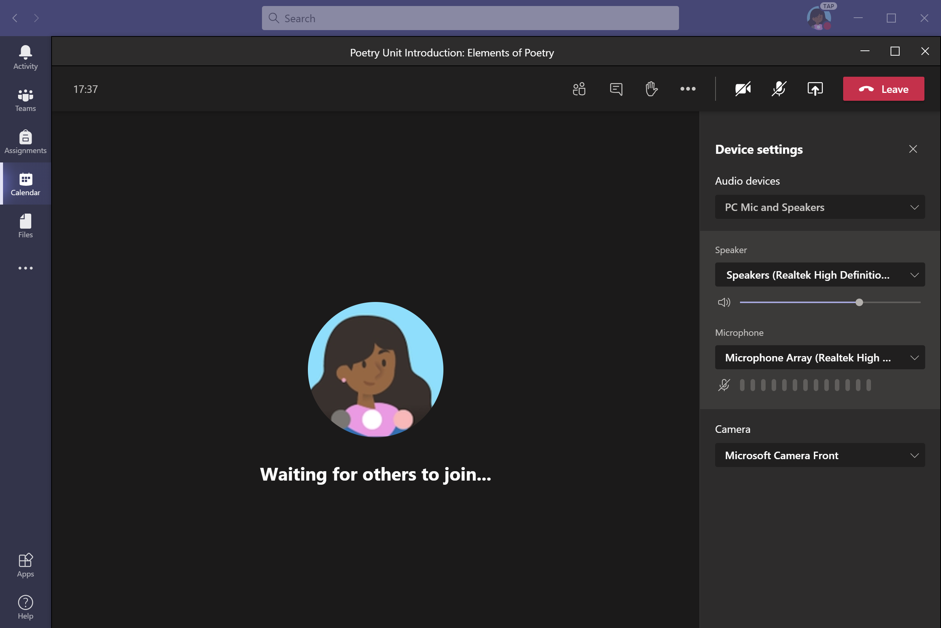
Select the speakers and microphone you wish to use.

Slide 46
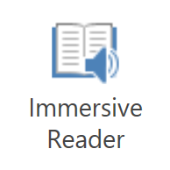
Using Immersive Reader

Slide 47
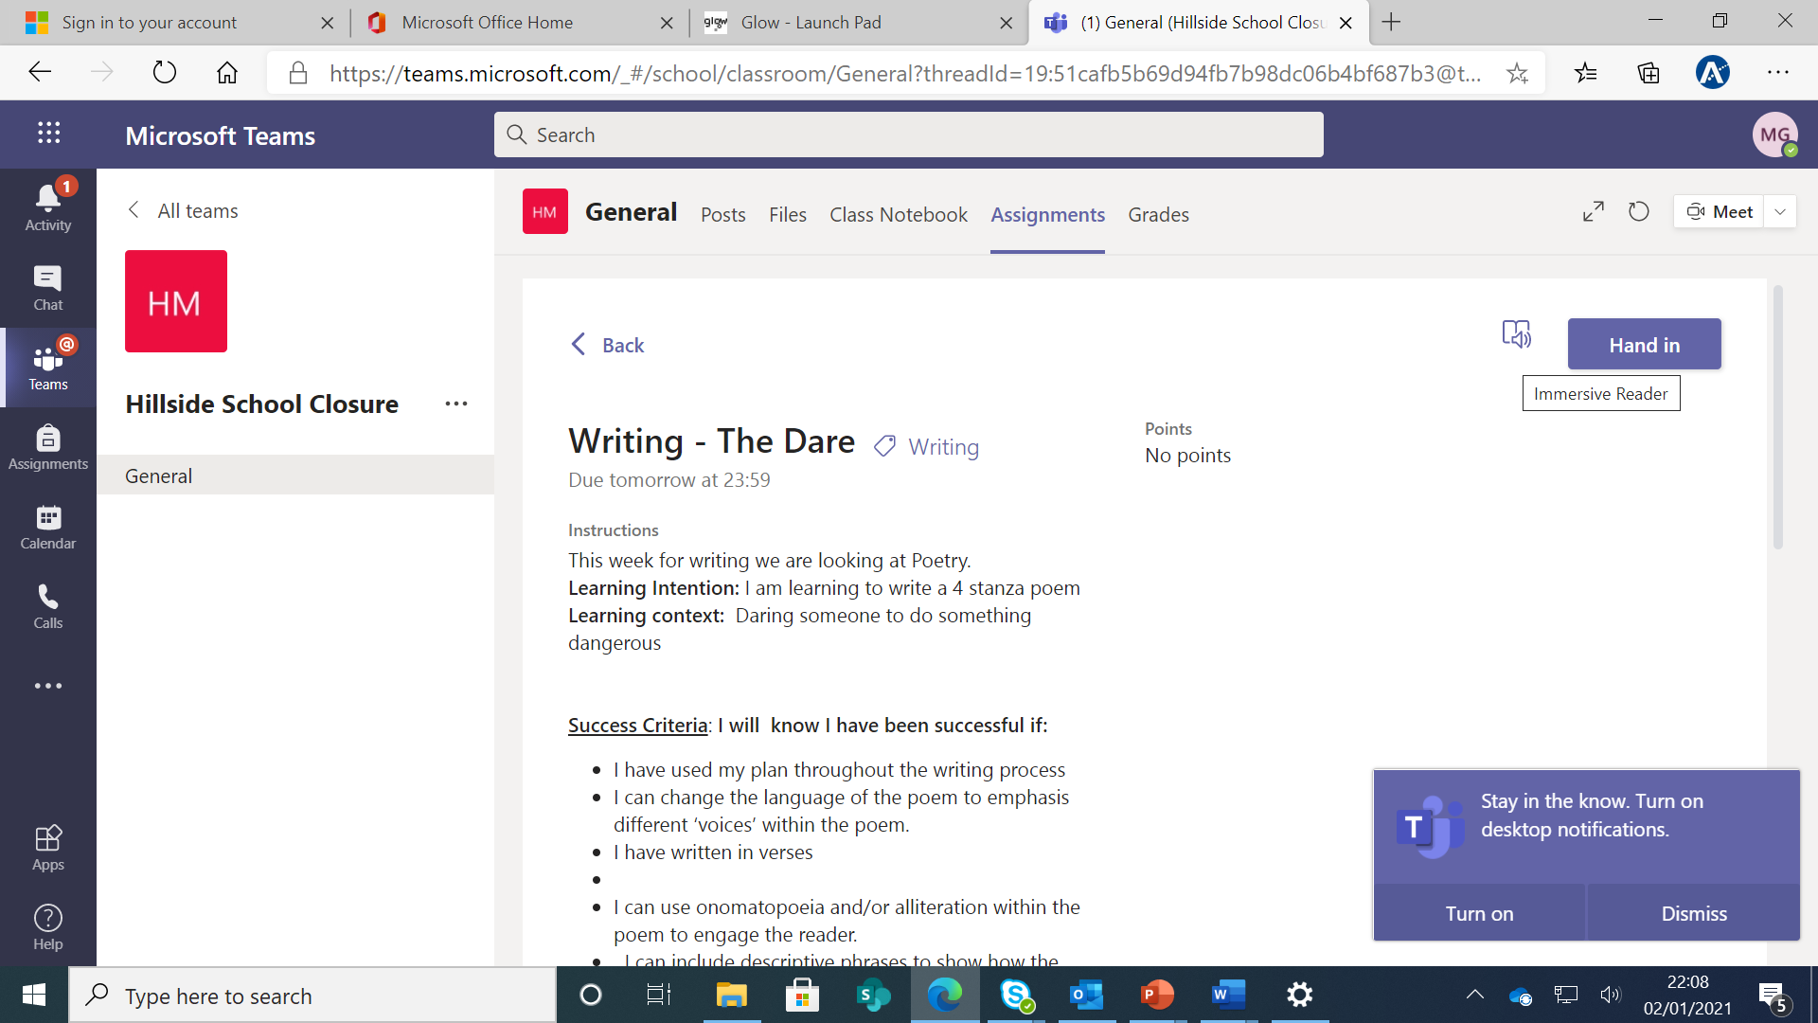
Click this icon for the computer to read the instructions to pupils.

Slide 48
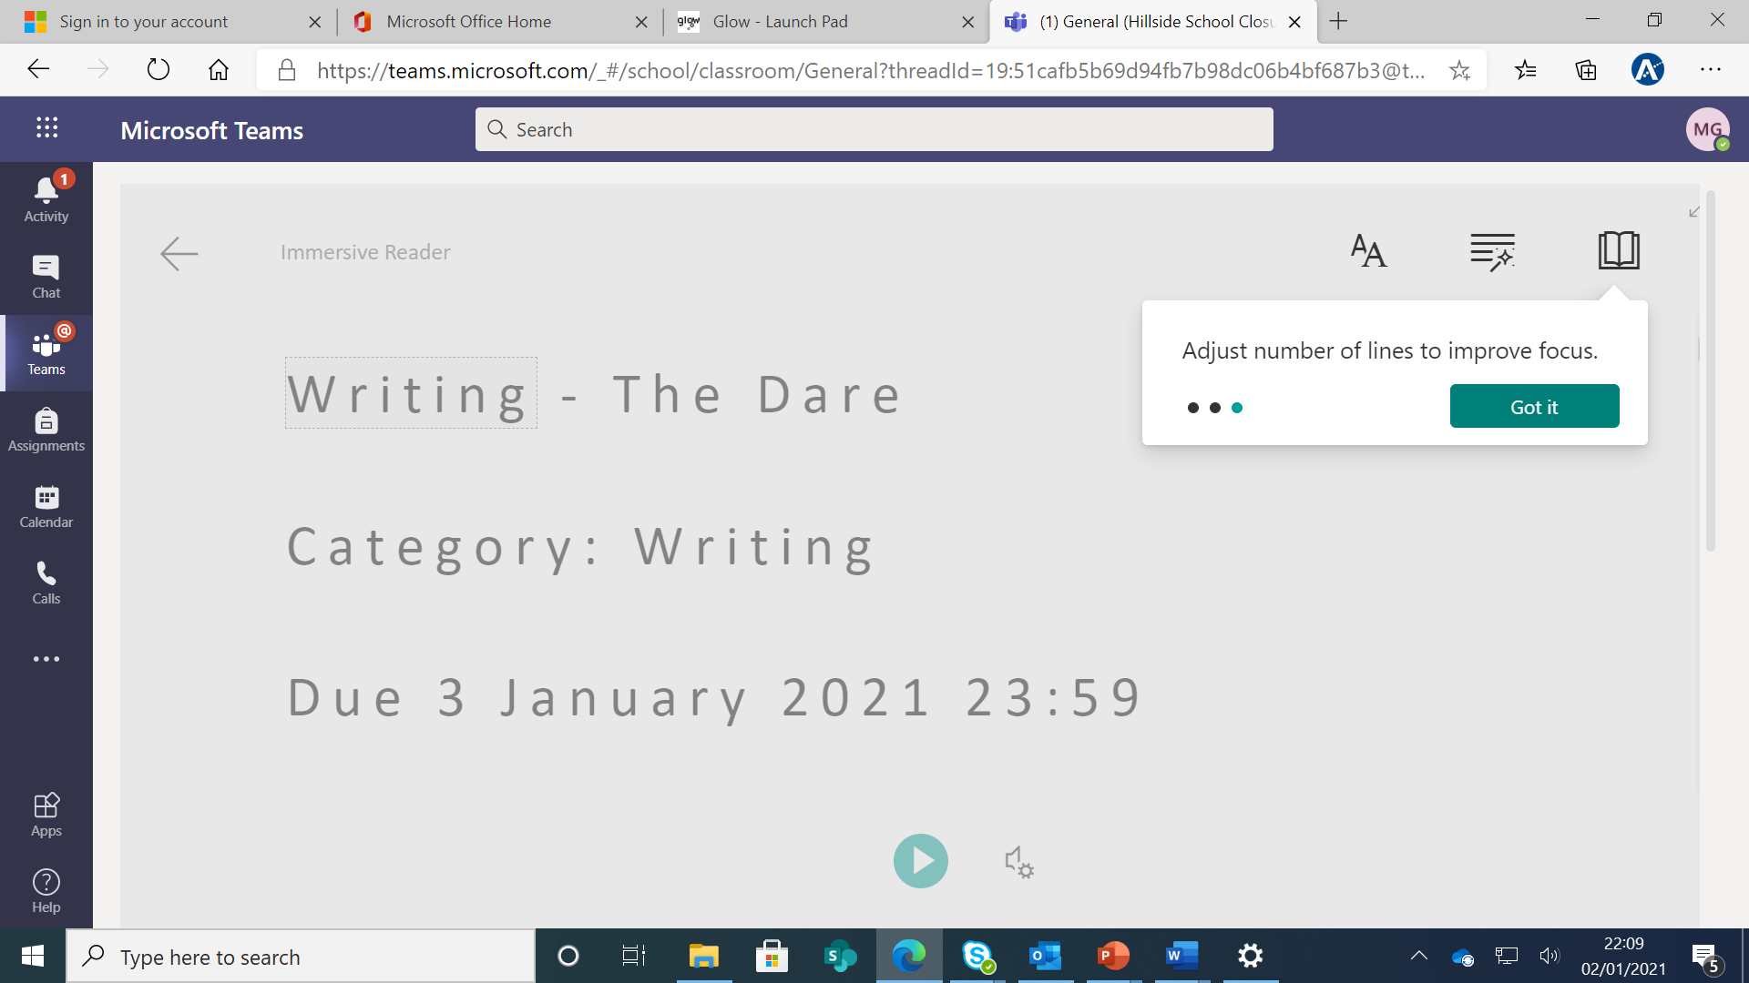
This allows you to change the font size, highlight grammar options and translate the text into a different language.

Slide 49
Click the green icon and the text will be read aloud.

Slide 50
FAQ’s & Troubleshooting

Slide 51
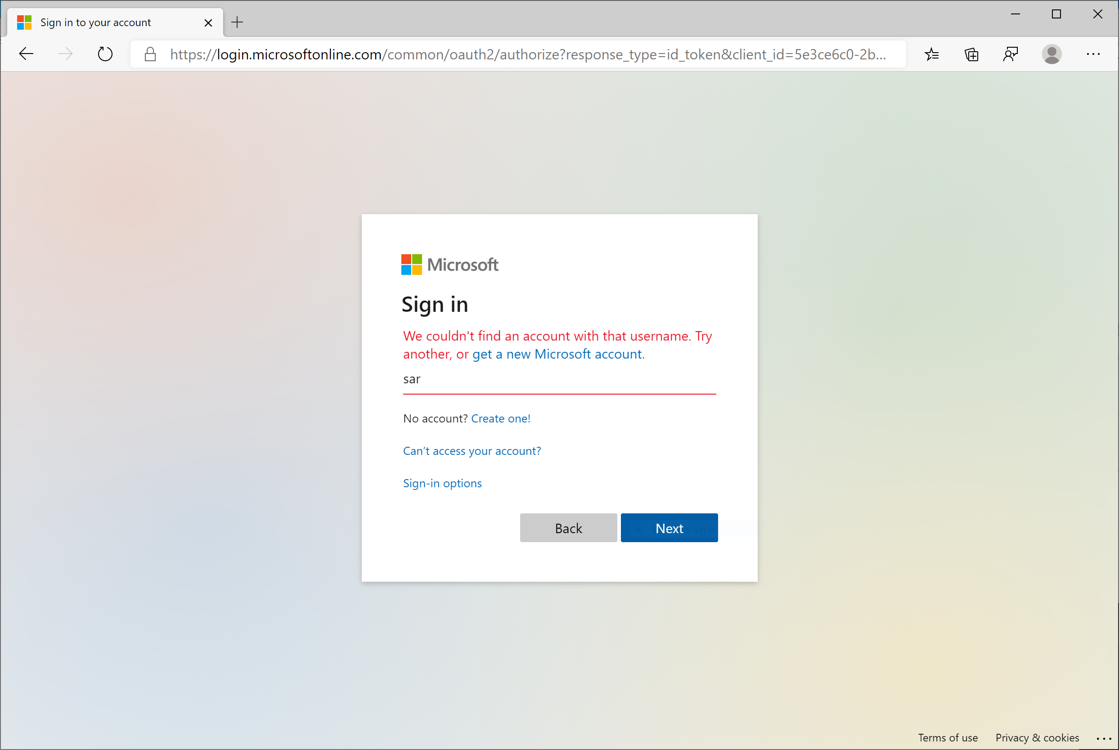
My child’s login isn’t working.
The login information may not be accurate or there might be an issue with the password. Contact the school directly for support.

Slide 52
2. My student’s assignments are missing.
Check the Assignments tab. If you don’t see any assignments, contact the school who will seek advice from the class teacher or Mrs Bain.

Slide 53
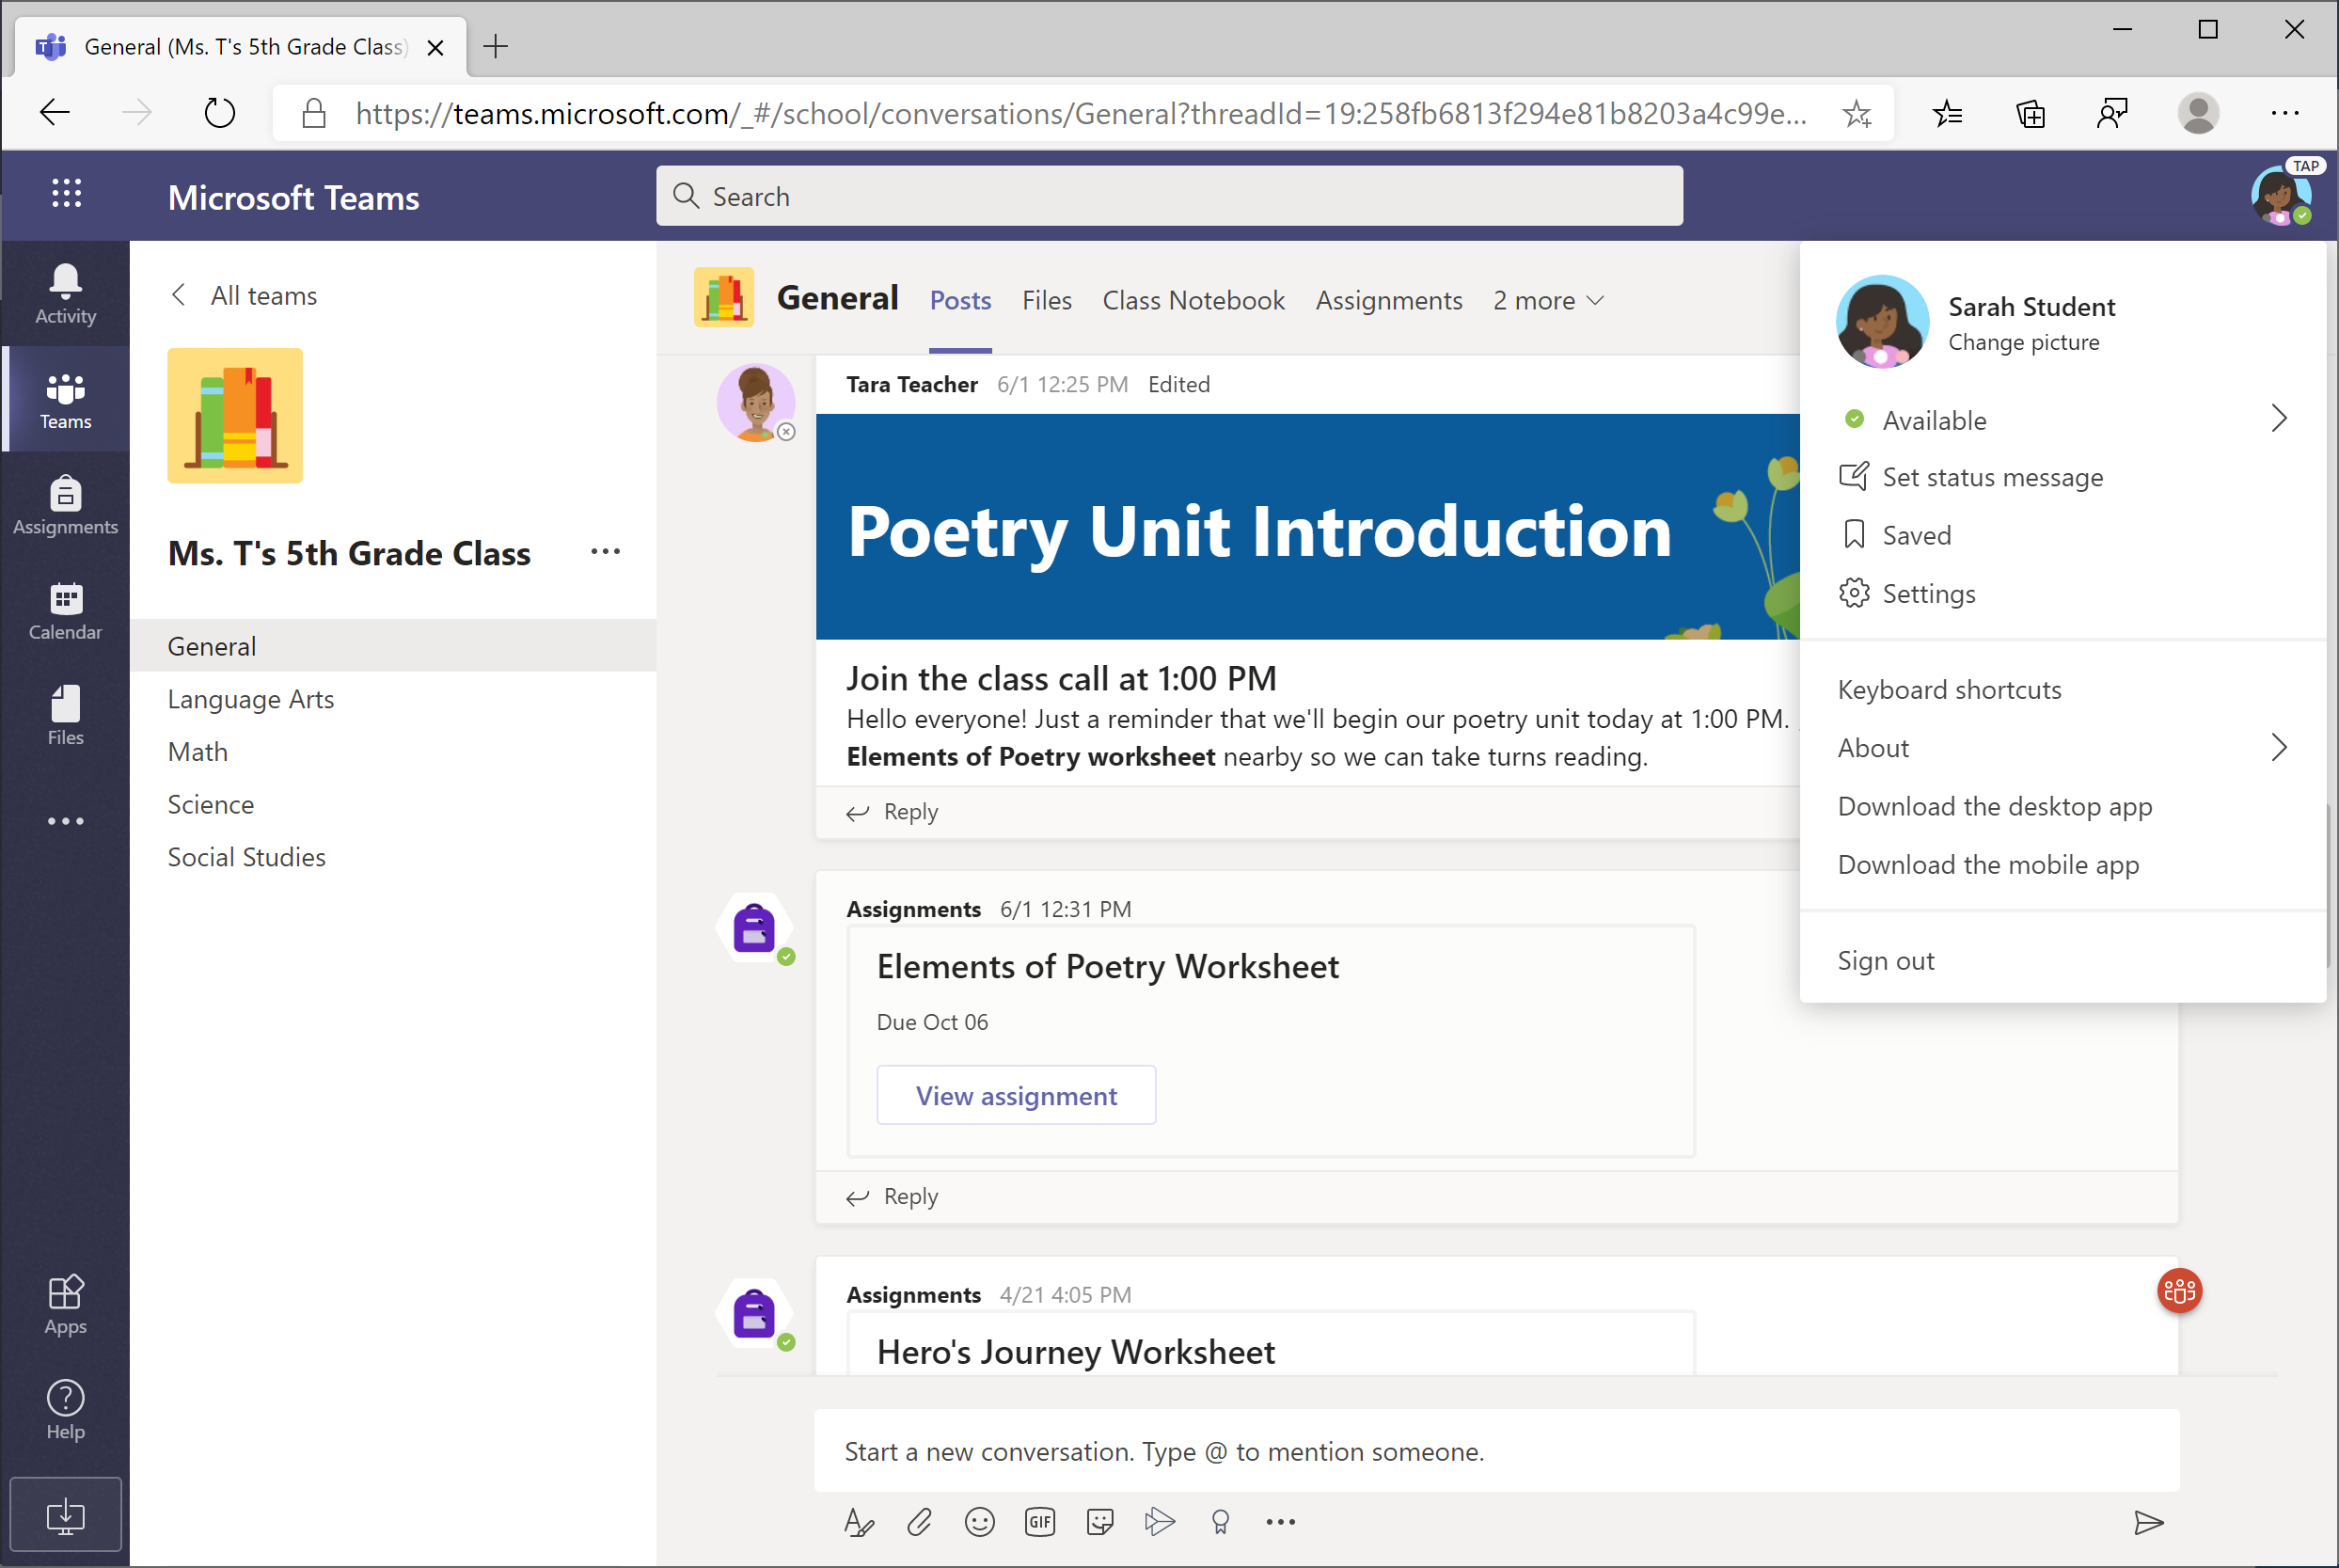
3. What if I have more than one child using Teams on one device?
Each pupil is able to log in to their own Teams account with their unique username and password.
IF using the Teams App on a tablet/phone when one child is finished with their Teams work, click on the in the top-left corner and select Add account. The next child can then log in. This will save multiple accounts and allow you to move between them without signing out.
Top tip if using a laptop: If you have more than one child accessing teams. Log one child in using Google Chrome and your other child using Microsoft Edge or another web browser. This should prevent you having to log in and out of multiple accounts.

Slide 54
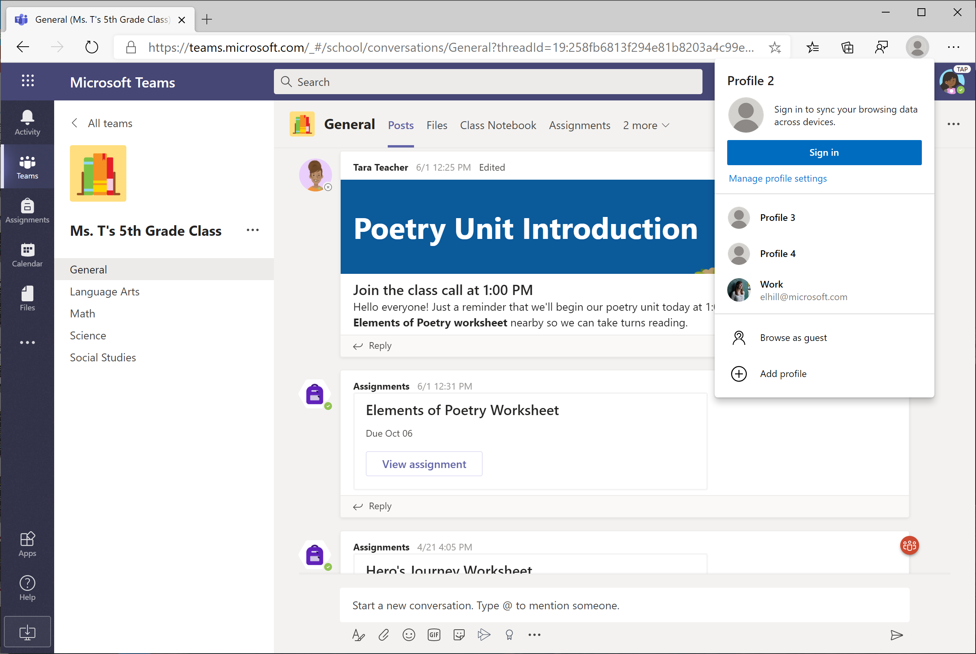
You can also create multiple accounts (also called profiles) in the new Edge browser.

Slide 55
4. We are experiencing low internet bandwidth. What can we do?
You can still use Teams when internet bandwidth is low. Teams will work to reduce the amount of video streams automatically.
You can try limiting video usage during live class sessions. Have your child turn on the camera at the beginning of the session to say hello, or have your student only use the camera when they are speaking.

Slide 56
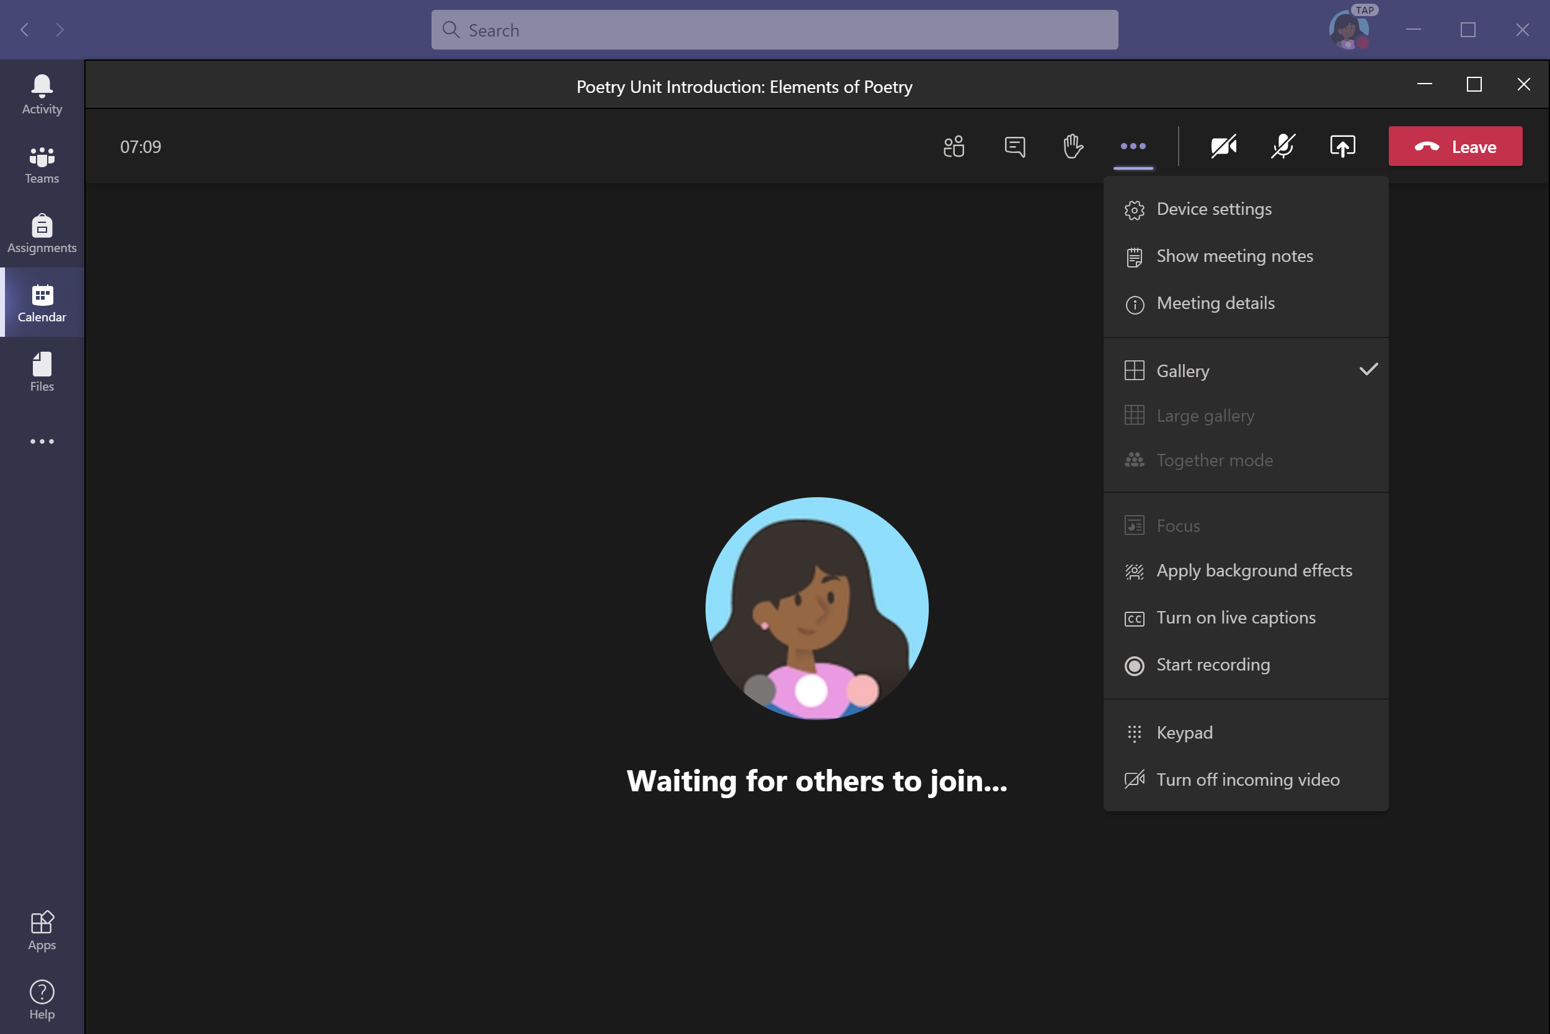
You can also turn off incoming video when bandwidth is low.
Click on the “. . .” (More Options) and select Turn off incoming video.

Slide 57
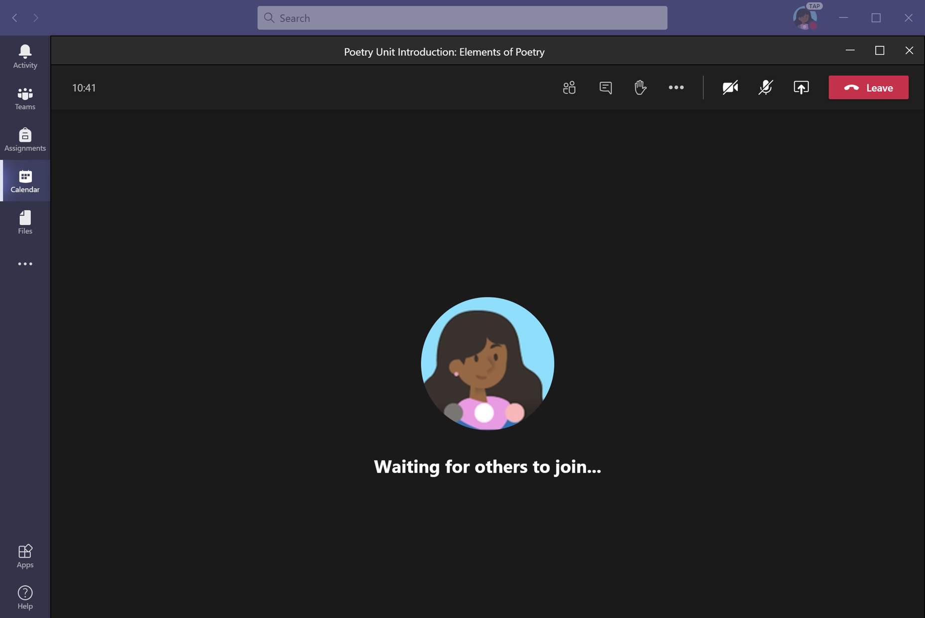
5. Audio troubleshooting: The teacher can’t hear my child, or my child can’t hear the teacher.
If people in a class meeting can't hear your child, they might be muted or the microphone setting might be incorrect.
Click the microphone icon to turn the mute button on/off.

Slide 58
To change your speaker or microphone settings in a meeting, select the “. . .” (More Options) button from the toolbar. Click Device settings.

Slide 59
Select the speakers and microphone you wish to use.

